Slide 1
Market Update
Dennis Mann
Export Sales Manager
Assembled for the
London Hardwood Club
June 2020

Slide 2
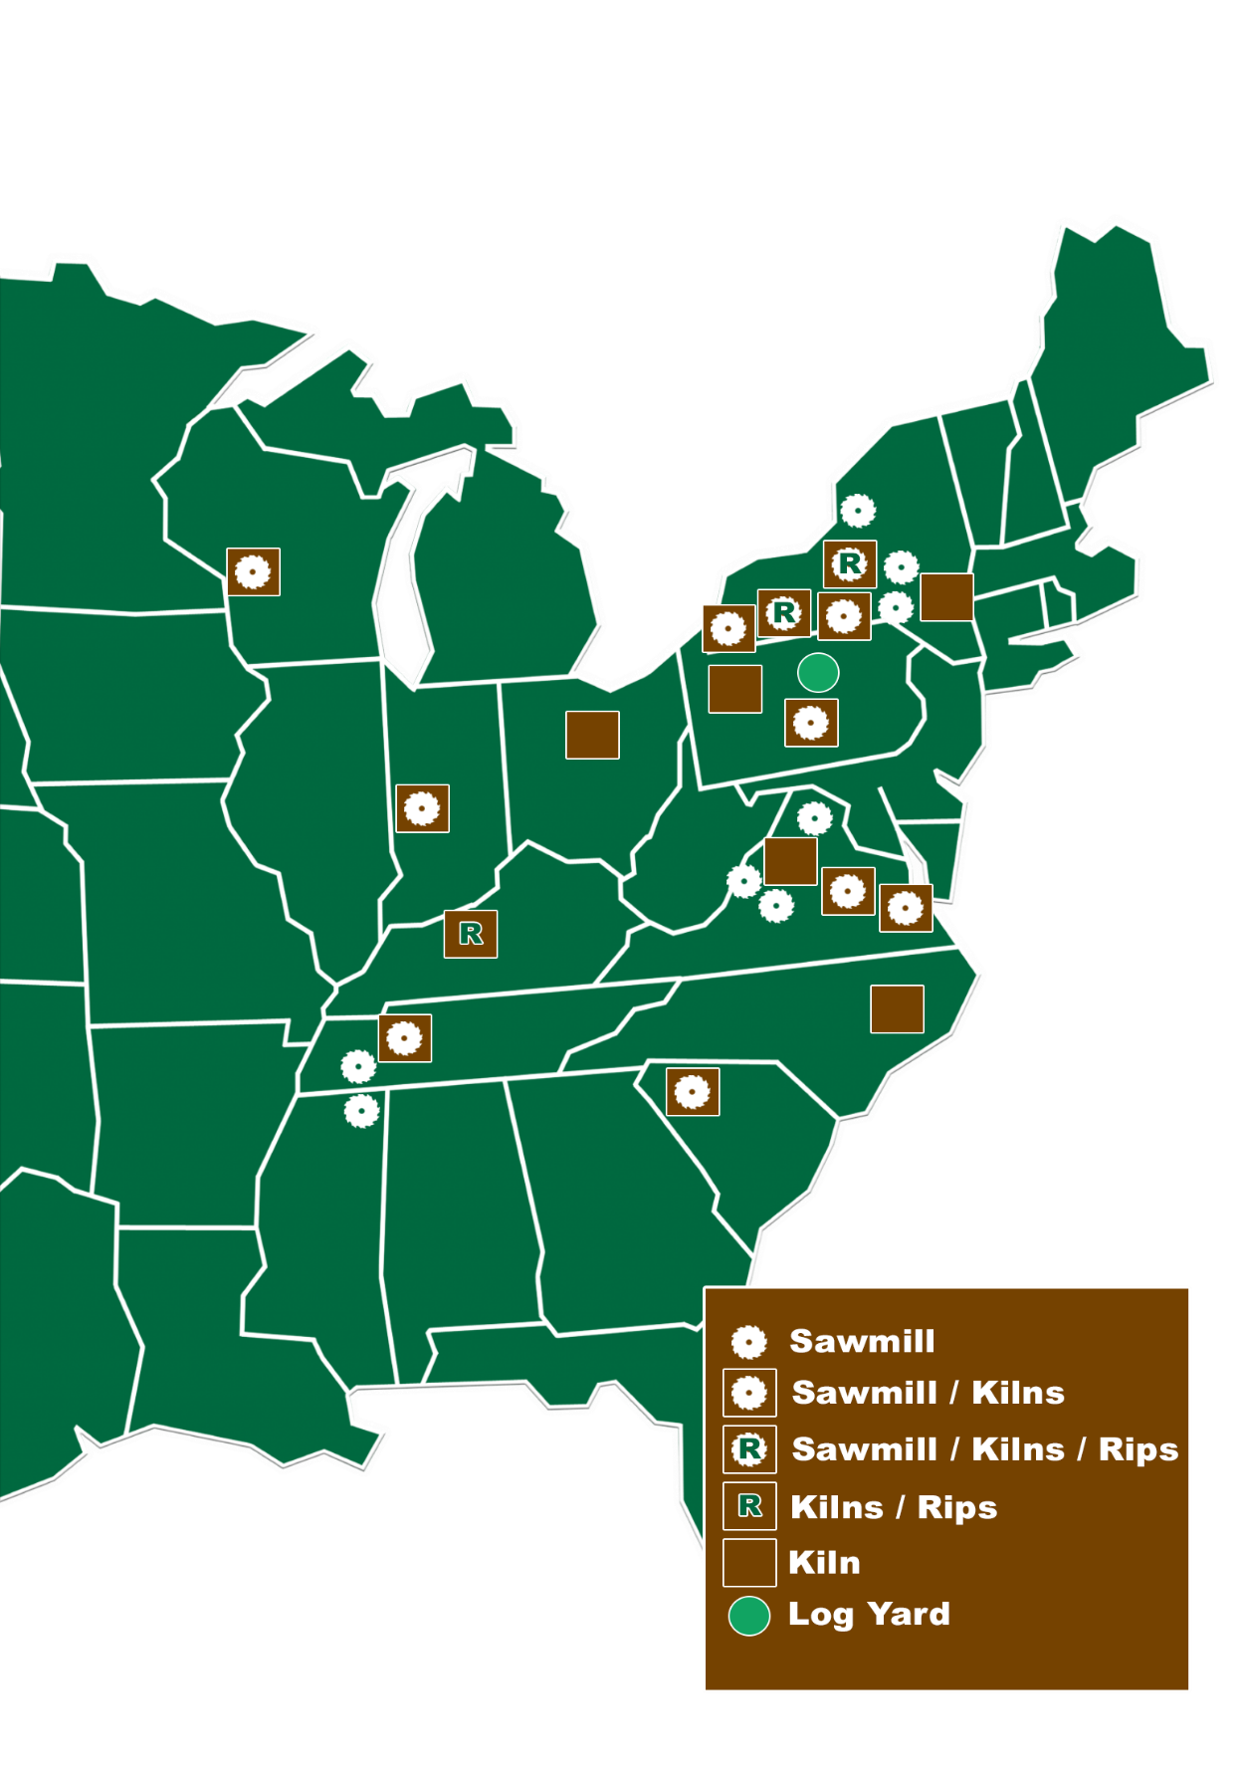
Access to the Supply You Need!
Also exclusive provider of

Slide 3
US Hardwood Export Totals
2008 2009 2010 2011 2012 2013 2014 2015 2016 2017 2018 2019 2020
Annualized

Slide 4
US Hardwood Lumber Exports to Top 10 Markets 1Q 2020
Source: U.S. Census Bureau Trade Data

Slide 5
UK Drives Hardwoods in Europe
US Hardwood Lumber Exports to Europe

Slide 6
UK Species Mix Consistent Year Over Year, (USD)
Walnut

Slide 7
UK Species Mix This Year, (m3)
2020
Poplar

Slide 8
Current State of Green Lumber Production
Prime
Grades
Sawmills are Struggling
COVID 19 Restrictions
Price Reductions on Industrials
-30% on 30%
Demand on Low Grade
Reduced Hours = Reduced Production
Industrial Grades
Ties
Cants
Pallet
Etc.
Common Grades

Slide 9
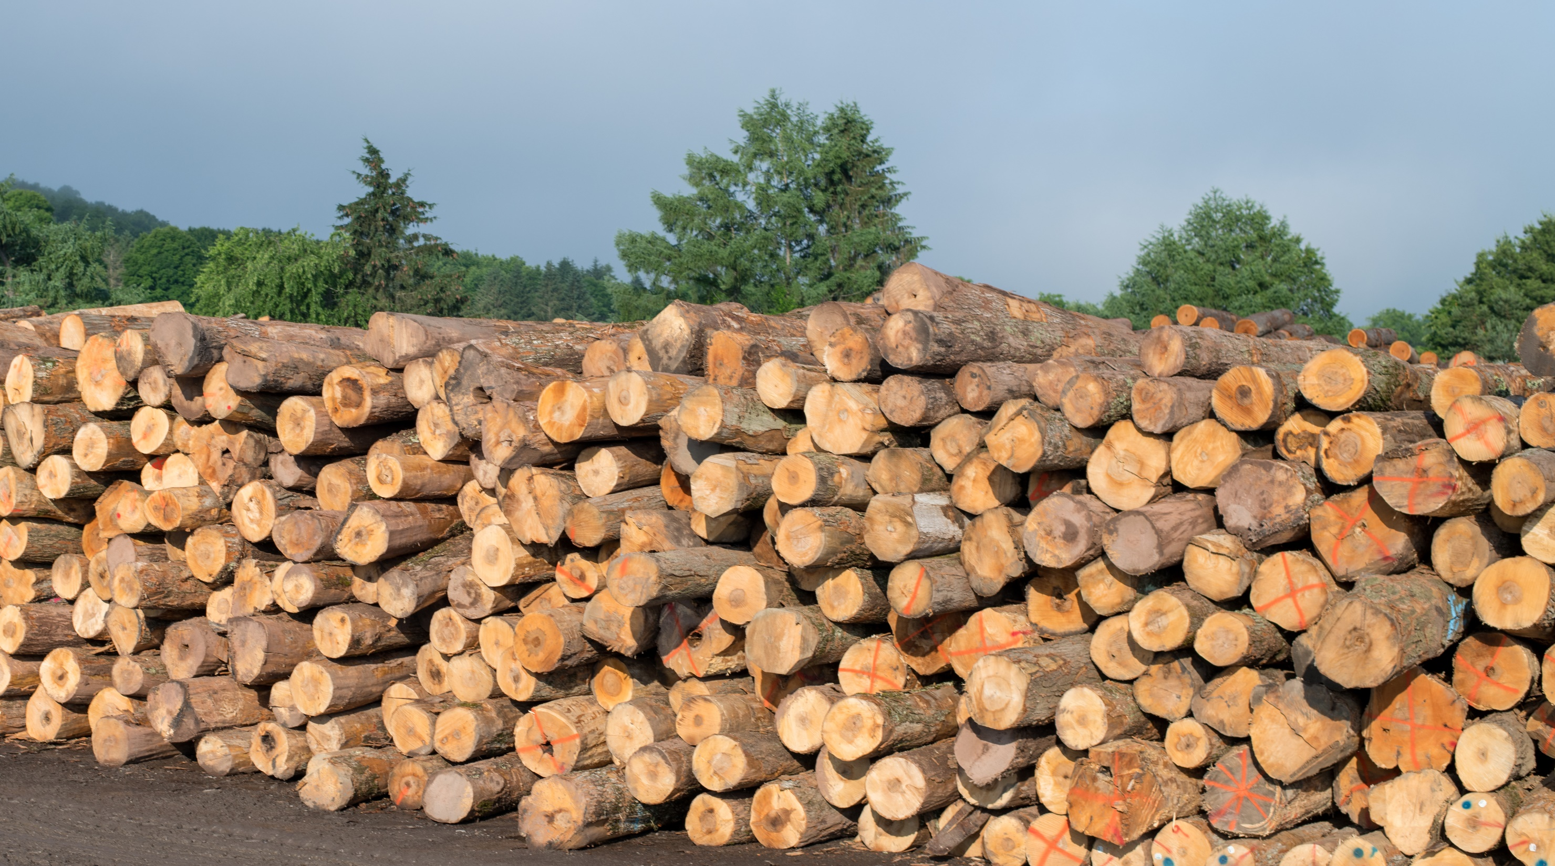
NEXT 60 DAYS

Slide 10
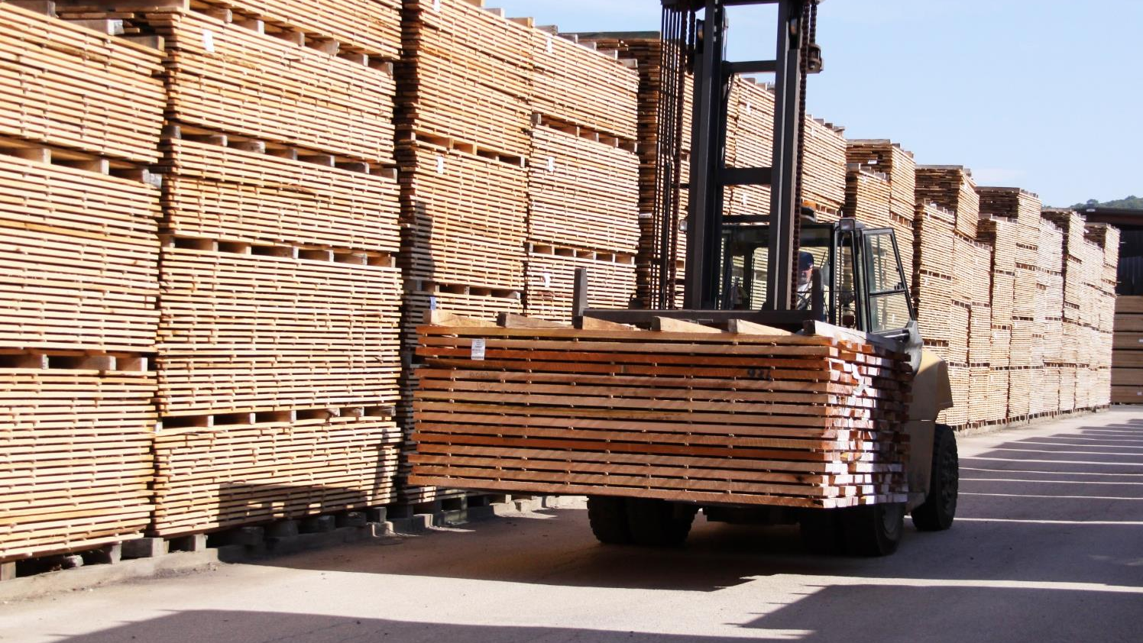
DISCUSSION

Slide 11
THANK
YOU

