Slide 1

AN INTRODUCTION TO NORTH AMERICAN HARDWOODS
Lumber Grades & Species
DANA SPESSERT
Chief Inspector, NHLA

Slide 2
Main Roles of NHLA
Education
Promotion
Advocacy
Networking
Industry Services

Slide 3
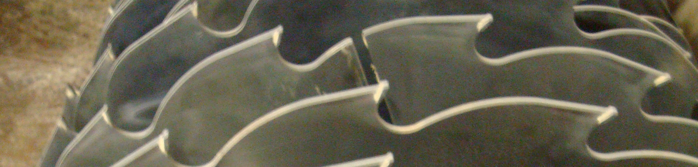

NHLA RULES
Established more than 100 years ago.
One of the only standard grading systems in the world.

Slide 4
Basic Principles of Grading Hardwoods
Measurable Percentage of Clear Wood
Determines Both Cost and Waste Factor
Cuttings (Pieces)
  Size
  Number

Slide 5
Basic Principles of Grading Hardwoods
Grading from the poor side
Each clear area of the board is measured and considered a “cutting” if large enough
Clear areas of the board are valued using the Cutting Unit Method

Slide 6
Cuttings
Definition of Cutting – Paragraph 29.
A cutting is a portion of a board of plank obtained by cross-cutting or ripping or by both… Diagonal cuttings are not permitted.
No
Yes
Yes
Yes
Yes
Yes

Slide 7
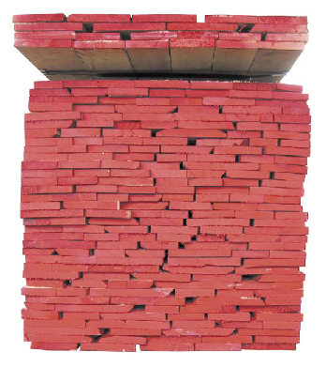
MEASUREMENT
CONVERSION FACTORS
1” = 4/4 = 25.4mm
2” = 8/4 = 50.8mm
1m= 3.281ft
^{*Average lengths are 7-12ft}
1000bf (1MBF) = 2.36m³
12,000bf = 28.3m³
1m³ = 424 board feet (BF)
1m³ = 35.315 cubic feet(cu.ft)

Slide 8
Cutting Unit Method
The percentage of cutting in a board is determined under the
Cutting Unit Method. Cutting unit is 1 inch by 1 foot:
12”
1”
12”
One square foot
contains 12 cutting units:
12”

Slide 9
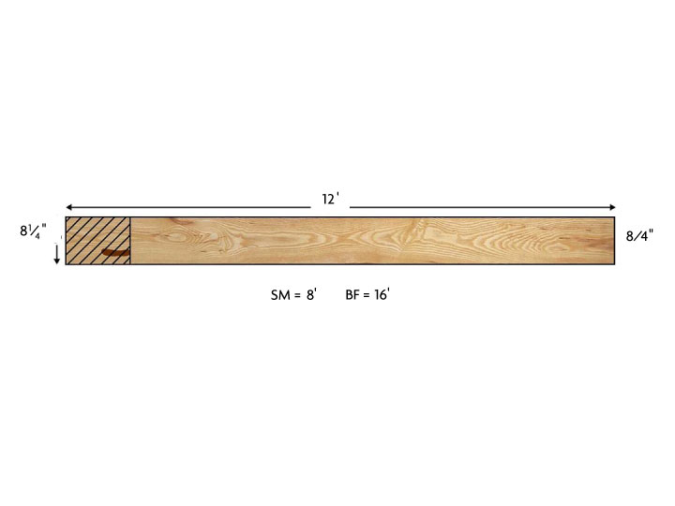
SURFACE MEASURE & BOARD FEET
SM = multiply the width of the board in inches by the length of the board in feet and divide the sum by 12, rounding up or down to the nearest whole number.

Slide 10
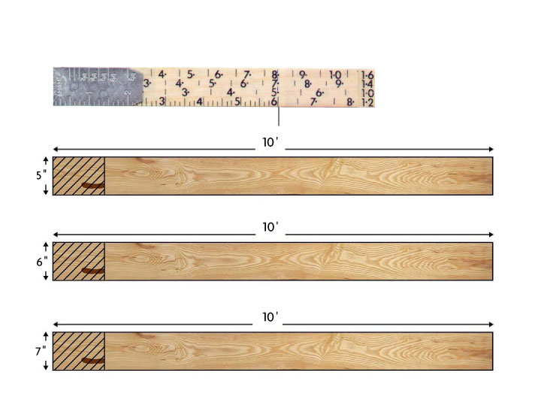
GRADING SCALE

Slide 11
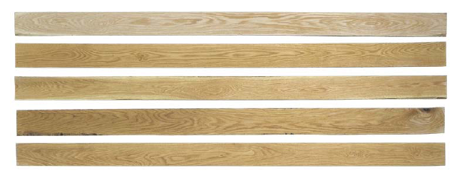
EXAMPLE OF FAS (RED OAK)

Slide 12
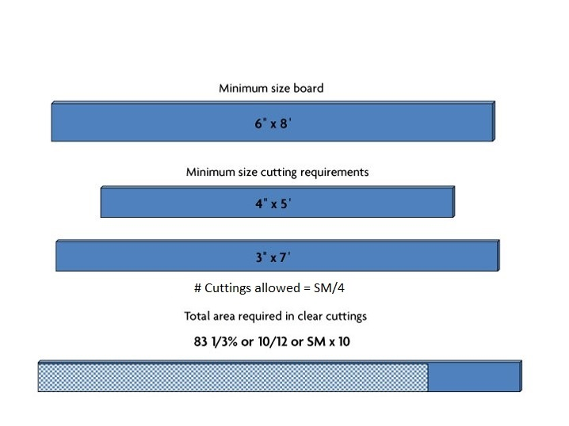
FAS REQUIREMENTS

Slide 13



Wane
12’
  6” x 10’ = 60 C.U.
6”
Knot
SM = 6” x
12’ ÷ 12 = 6’
Number of Cuttings for FAS:
SM ÷ 4 = 6/4 = 1½ = 1 cutting
Cutting Units needed for FAS: SM x 10 = 6 x 10 = 60 C.U.

Slide 14

Wane
12’
6” x 7’ = 42 C.U.
8” x 5’ = 40 C.U.
12”
6” x 6½’ = 39 C.U.
Knot
SM = 12” x 12’ ÷ 12 = 12’
Number of Cuttings for FAS: SM
÷ 4 = 12/4 = 3 cuttings
Cutting Units needed for FAS: SM x 10 = 12 x 10 = 120 C.U.
42 + 39 + 40 = 121 C.U.

Slide 15


Knot
Wane
12’
3” x 8’ = 24 C.U.
5” x 12’ = 60 C.U.
8”
SM = 8” x 12’ ÷ 12 = 8’
Number of Cuttings for FAS:
SM ÷ 4 = 8/4
= 2 cuttings
Cutting Units needed for FAS: SM x 10 = 8 x 10 = 80 C.U.
24 + 60 = 84 C.U.

Slide 16
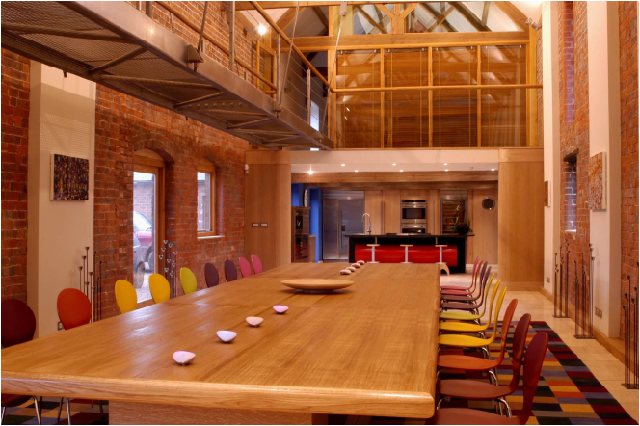
FAS APPLICATIONS

Slide 17
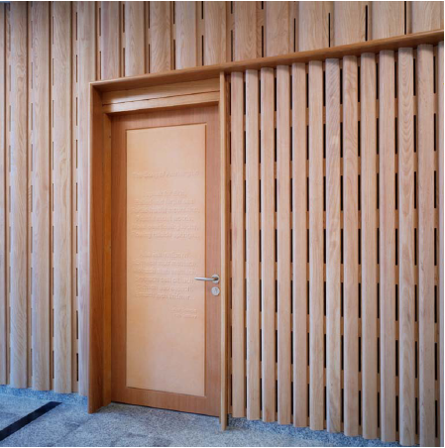
FAS APPLICATIONS

Slide 18
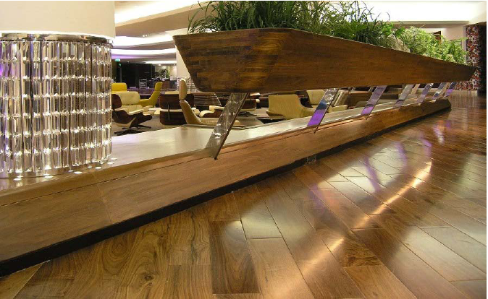
FAS APPLICATIONS

Slide 19
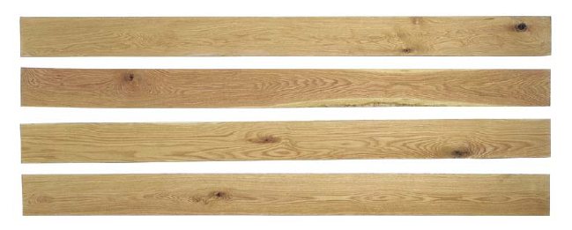
EXAMPLE OF Nº 1 COMMON (RED OAK)

Slide 20
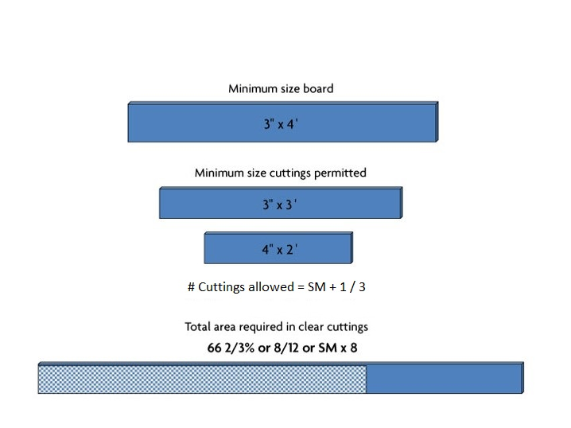
Nº 1 COMMON REQUIREMENTS

Slide 21
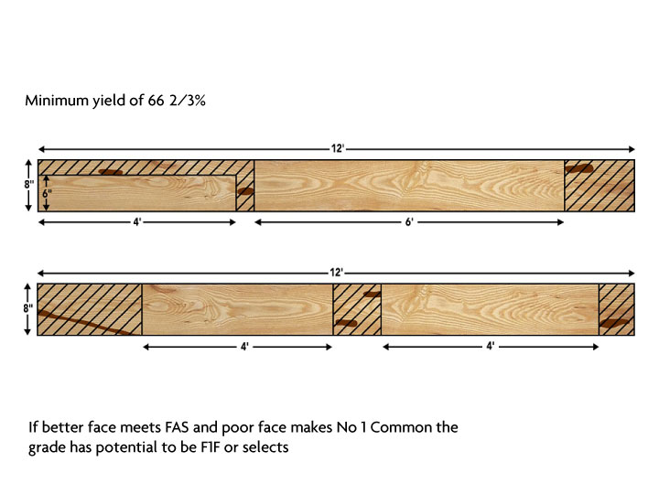
Nº 1 COMMON REQUIREMENTS
If better face meets FAS and poor face makes No 1 Common the grade has potential to be F1F or selects.

Slide 22
#1 Common
8’
Wane
4” x 8’ = 32 C.U.
6”
Wane
SM
= 6” x 8’ ÷ 12 = 4’
Number of Cuttings for #1 Com:
SM+1 ÷ 3 = 5 ÷ 3
= 1 cutting
Cutting Units needed for #1 Com: SM x 8 = 4 x 8 = 32 C.U.

Slide 23
#1 Common
Knot
12’
Wane
3½” x 4½‘ = 15¾ C.U.
4½” x 4½’ = 20¼ C.U.
8½” x 4½’ = 38¼ C.U.
12”
6” x 5 2/3’ = 34 C.U.
Wane
SM = 12”
x 12’ ÷ 12 = 12’
Number of Cuttings for #1Com: SM+1 ÷ 3 = 13 ÷ 3 = 4 cuttings
Cutting Units needed for #1Com: SM x 8 = 12 x 8 = 96 C.U.
15¾ + 20¼ + 38¼ + 34 = 108¼ C.U.

Slide 24
#1 Common
12’
Knot
Wane
3” x 8’ = 24 C.U.
7”
4” x 11’ = 44 C.U.
Wane
SM = 7” x 12’ ÷ 12 = 7’
Number of Cuttings for #1 Com:
SM+1 ÷ 3 = 8÷3
= 2 Cuttings
= 56.
Cutting Units needed for #1 Com: SM x 8 = 7 x 8
24 + 44 = 68 C.U.

Slide 25
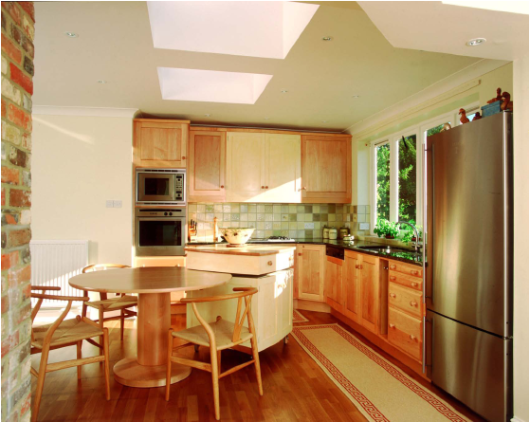
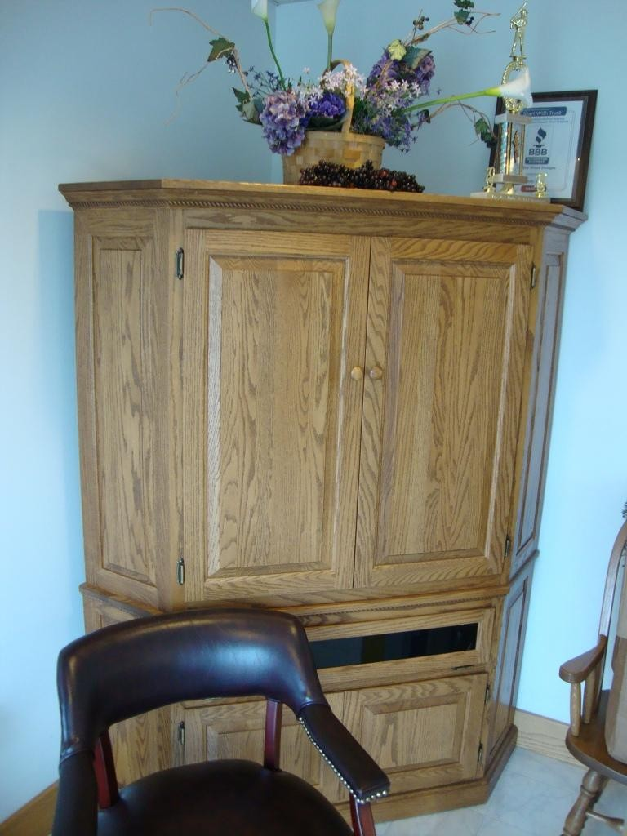
Nº 1 COMMON APPLICATIONS

Slide 26
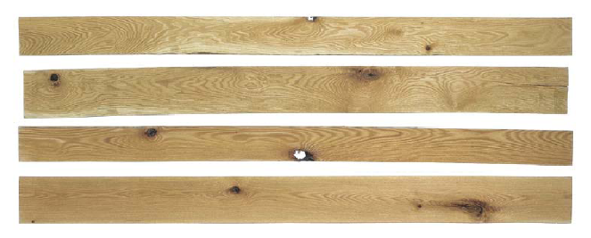
EXAMPLE OF Nº 2 COMMON (RED OAK)

Slide 27
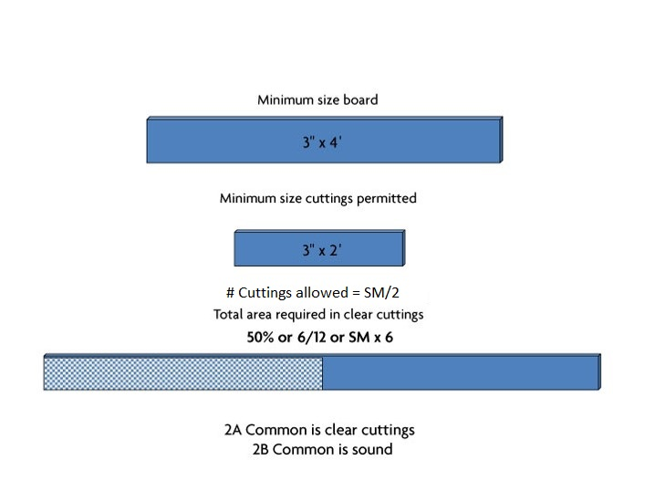
Nº 2 COMMON REQUIREMENTS
2A Common is clear cuttings
2B Common is sound

Slide 28
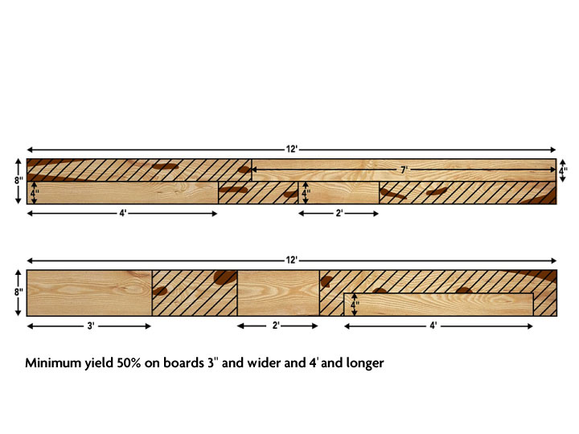
Nº 2 COMMON REQUIREMENTS

Slide 29
#2A Common
Wane
9’
Knot
6” x 2½’ = 15 C.U.
4” x 5’ = 20 C.U.
7”
Wane
SM = 7” x 9’ ÷
12 = 5’
Number of Cuttings for #2A Com:
SM ÷ 2 = 2 cuttings
Cutting Units needed for #2A Com: SM x 6 = 5 x 6 = 30
20 + 15 = 35 C.U.
Clear-face cuttings
C.U.

Slide 30
#2A Common
Wane
12’
Wane
12” x 3½’ = 42 C.U.
6” x 3’ = 18 C.U.
12”
5” x 2’ = 10
C.U.
3½” x 4’ = 14 C.U.
Knot
Knot
SM = 12” x 12’ ÷ 12
Number of Cuttings
= 12’
for #2 Com:
SM ÷ 2 = 12÷2 = 6 Cuttings
Cutting Units needed for #2 Com: SM x 6 = 12 x 6 = 72 C.U.
10 + 18 + 14 + 42 = 84 C.U.
Clear-face cuttings

Slide 31
#2B Common
Wane
12’
Checks
Wane
12” x 3½’ = 42 C.U.
6” x 3’ = 18 C.U.
12”
5” x 2’ = 10
C.U.
3½” x 4’ = 14 C.U.
Worm holes
Knot Split
SM = 12” x 12’ ÷ 12
Number of Cuttings
= 12’
for #2 Com:
SM ÷ 2 =
12÷2 = 6 Cuttings
Cutting Units needed for #2 Com: SM x 6 = 12 x 6 = 72 C.U.
10 + 18 + 14 + 42 = 84 C.U.
Sound cuttings

Slide 32
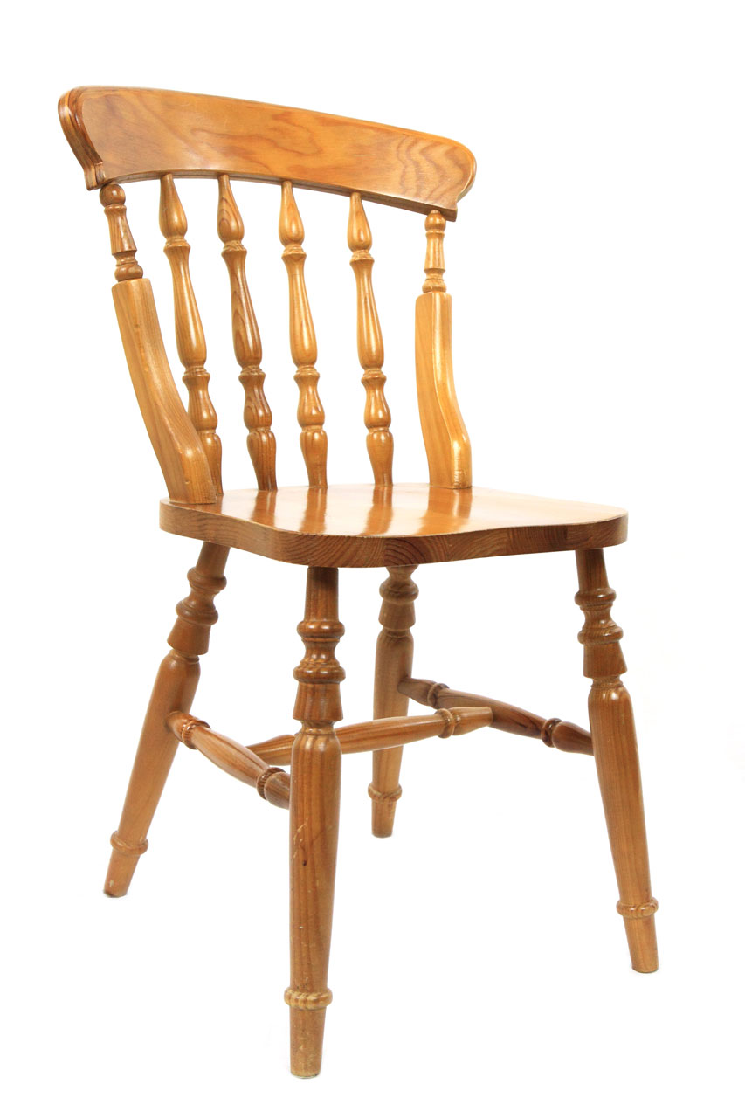
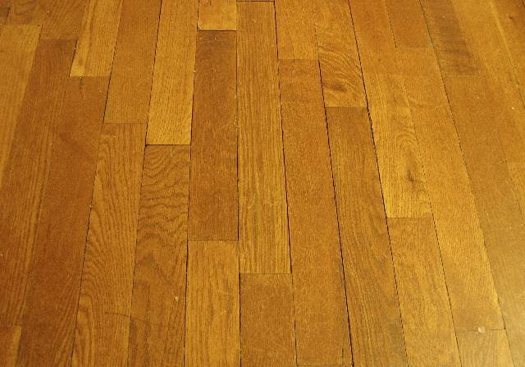
Nº 2 COMMON APPLICATIONS

Slide 33
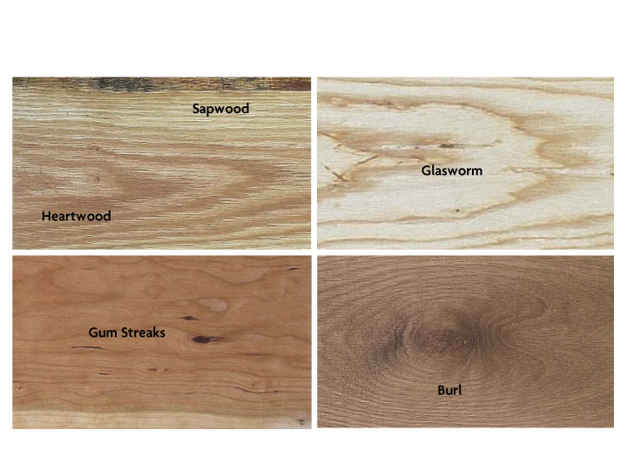
Characteristics Allowed in Clear Face Cuttings

Slide 34
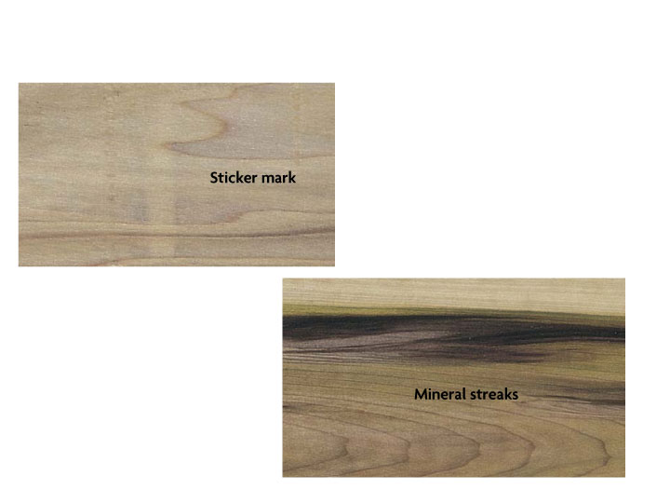
Characteristics Allowed in Clear Face Cuttings

Slide 35
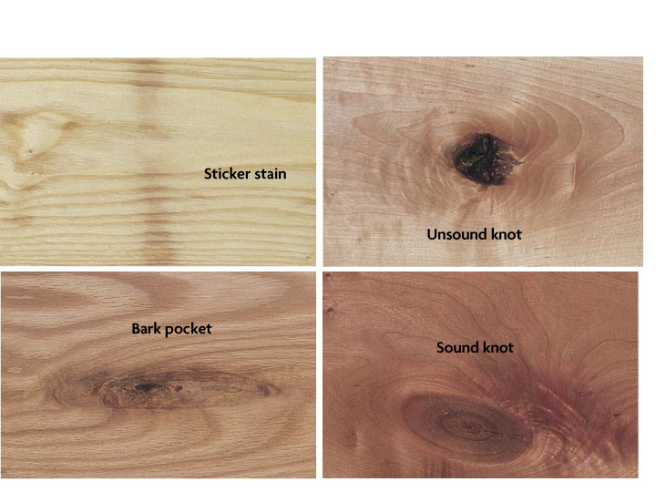
Characteristics Not Allowed in Clear Face Cuttings

Slide 36
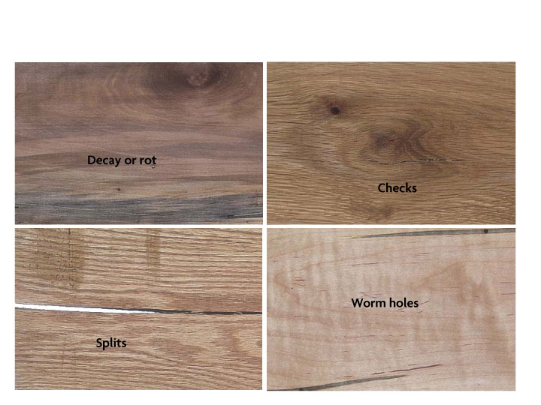
Characteristics Not Allowed in Clear Face Cuttings

Slide 37
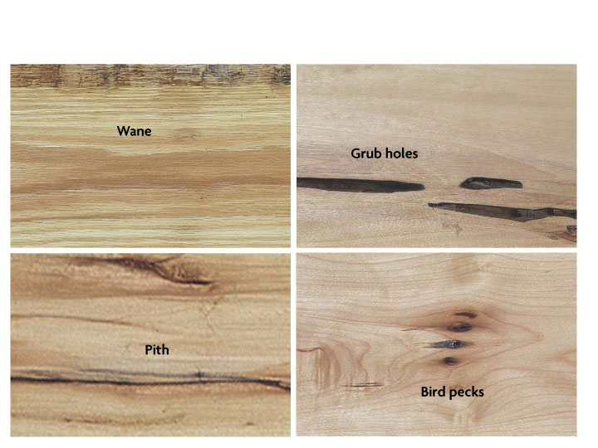
Characteristics Not Allowed in Clear Face Cuttings

Slide 38
NHLA
Grading
Chart
FAS
F1F
Select
#1 Common
#2A & #2B Common
#3 A Common
#3 B
Common
Minimum
Board Size
6’’ x 8’
6’’ x 8’
4’’ x 6’
3’’ x 4’
3’’ x 4’
3’’ x 4’
3’’ x 4’
Minimum
Cutting Size
4’’x 5’
3’’x 7’
Better Face to
Grade FAS
Poor Face to
Grade #1
Common
4’’x 2’
3’’x 3’
3’’ x 2’
3’’ x 2’
Not less than
containing 36
1½”wide
square inches
Basic Yield
83% or
SM x 10
66% or
SM x 8
50% or
SM x 6
33% or
SM x 4
25% or
SM x 3
Formula to Determine Number of Cuttings
SM
4
(4 max.)
SM+1
3
(5 max.)
SM
2
(7 max.)
Unlimited
Unlimited
cuttings
sound

Slide 39
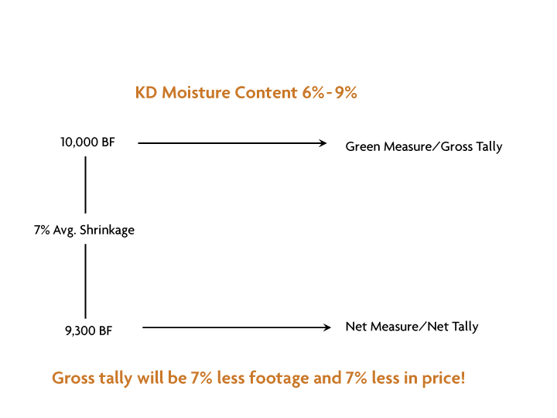
KILN DRYING HARDWOOD LUMBER

Slide 40
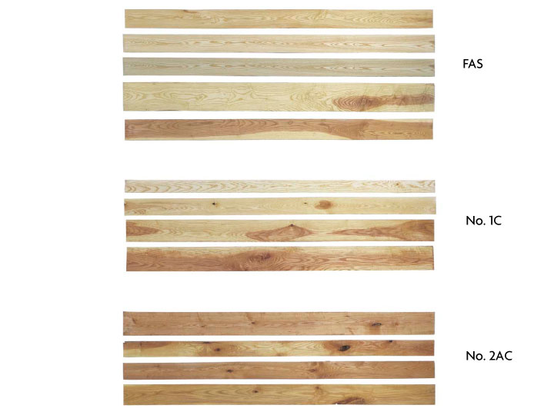
ASH SAMPLES

Slide 41
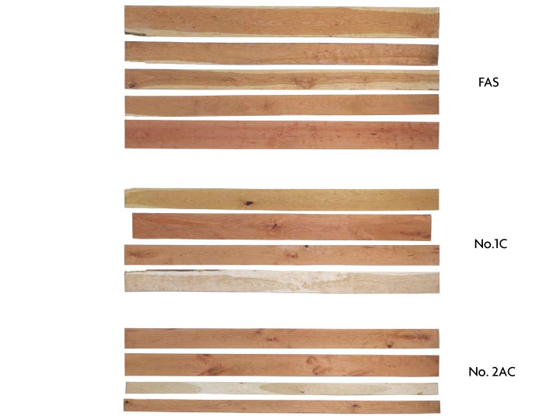
CHERRY SAMPLES

Slide 42
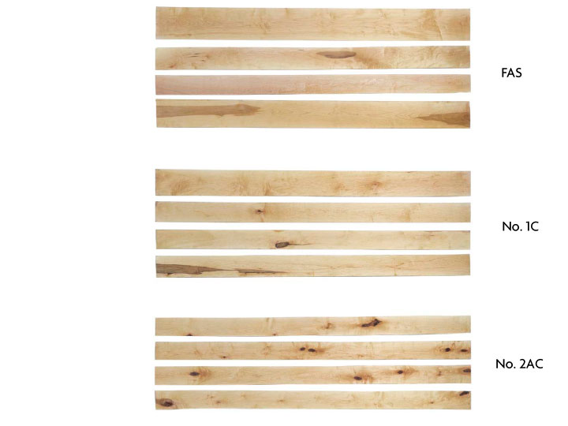
HARD MAPLE SAMPLES

Slide 43
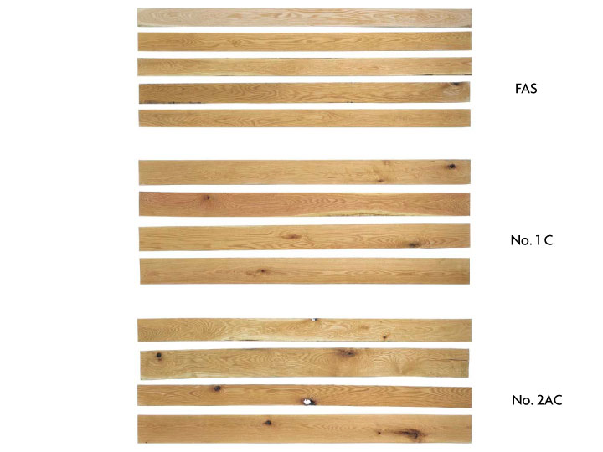
RED OAK SAMPLES

Slide 44
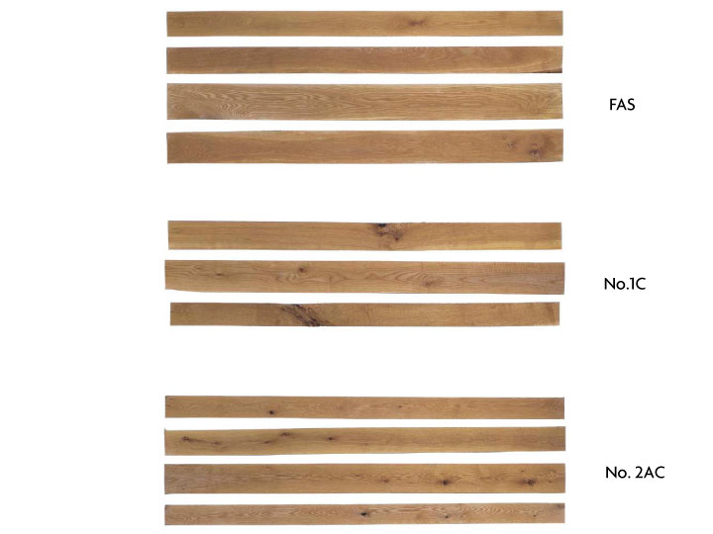
WHITE OAK SAMPLES

Slide 45
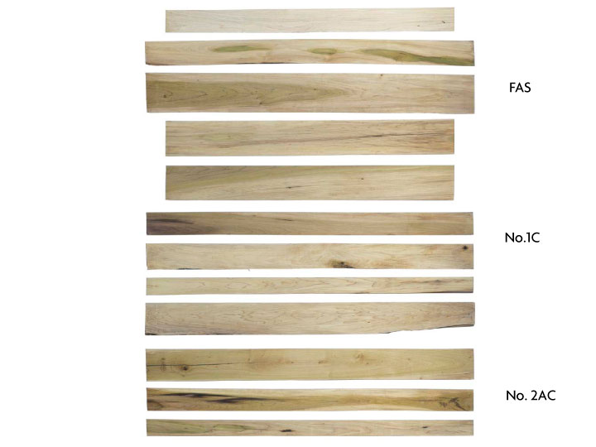
TULIPWOOD SAMPLES

Slide 46
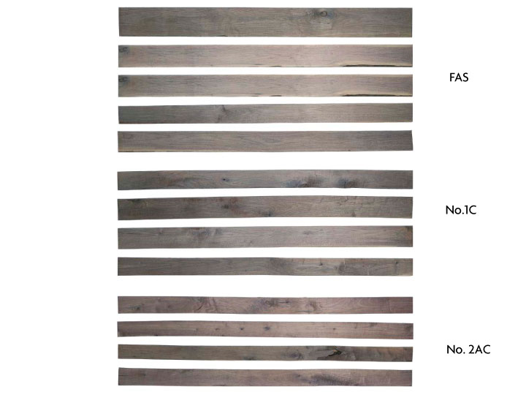
WALNUT SAMPLES

Slide 47
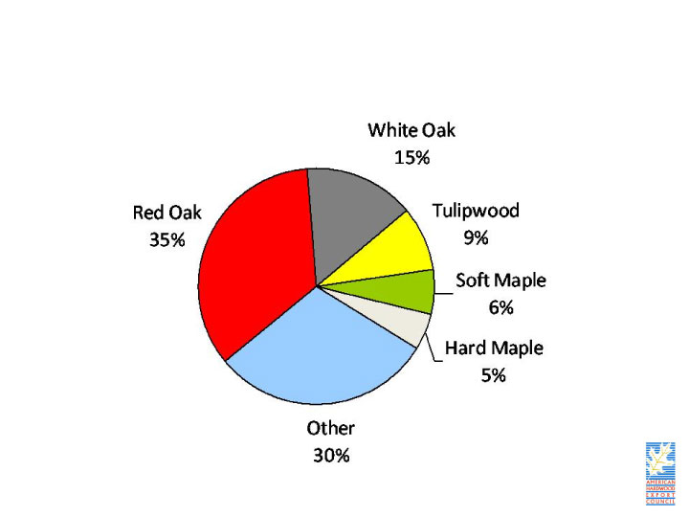
SUMMARY OF US HARDWOOD LUMBER SPECIES

Slide 48
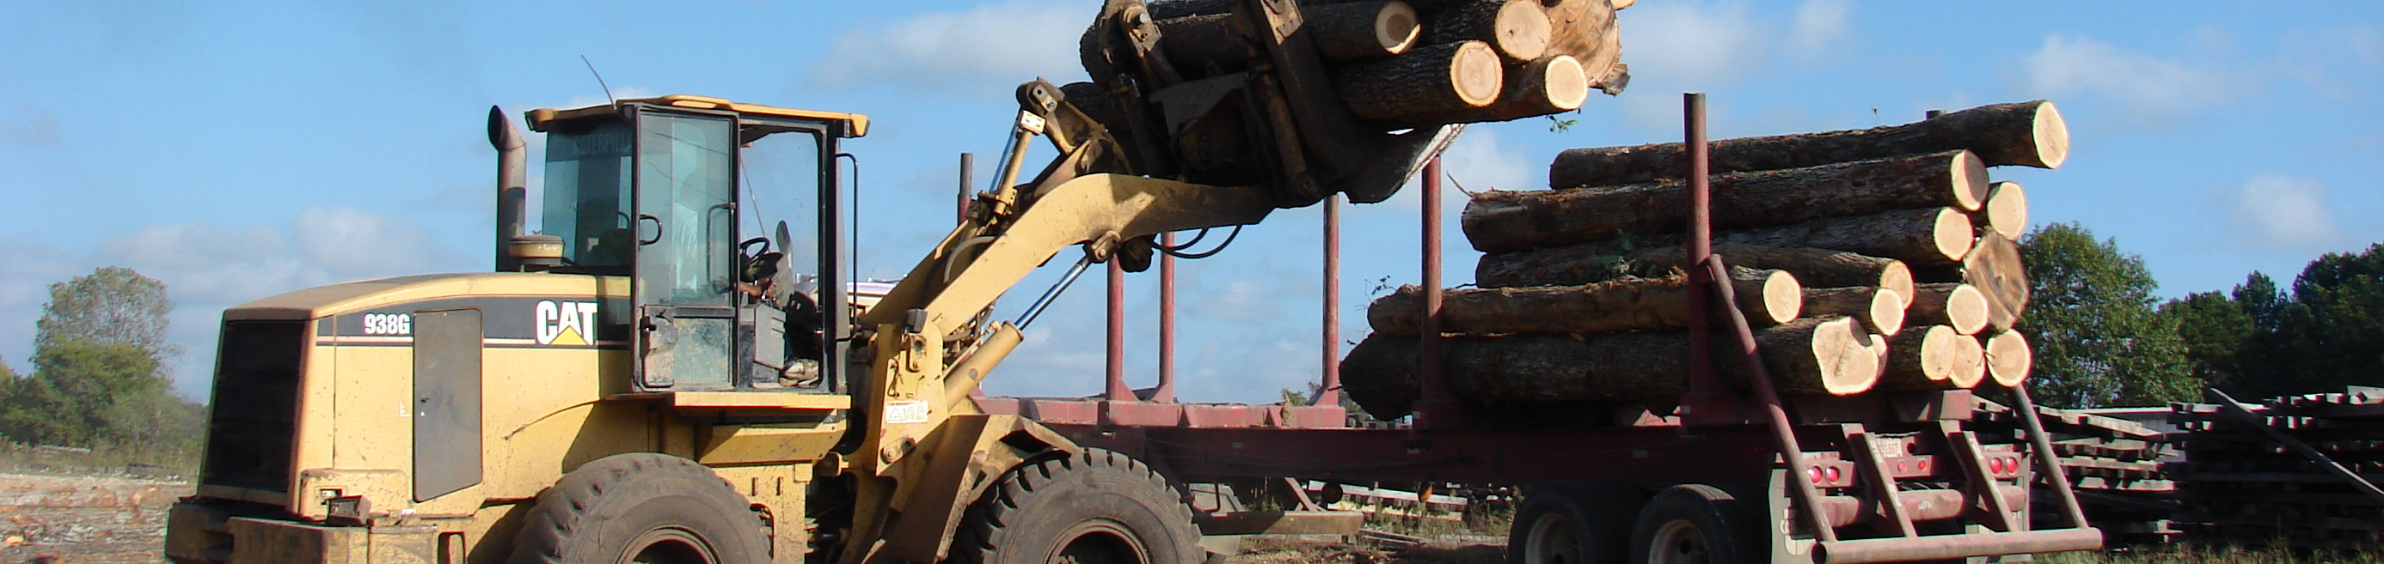

KEY POINTS WHEN BUYING OR SPECIFYING
US HARDWOODS
Know the product
Understand the grades
Communicate with your supplier

Slide 49
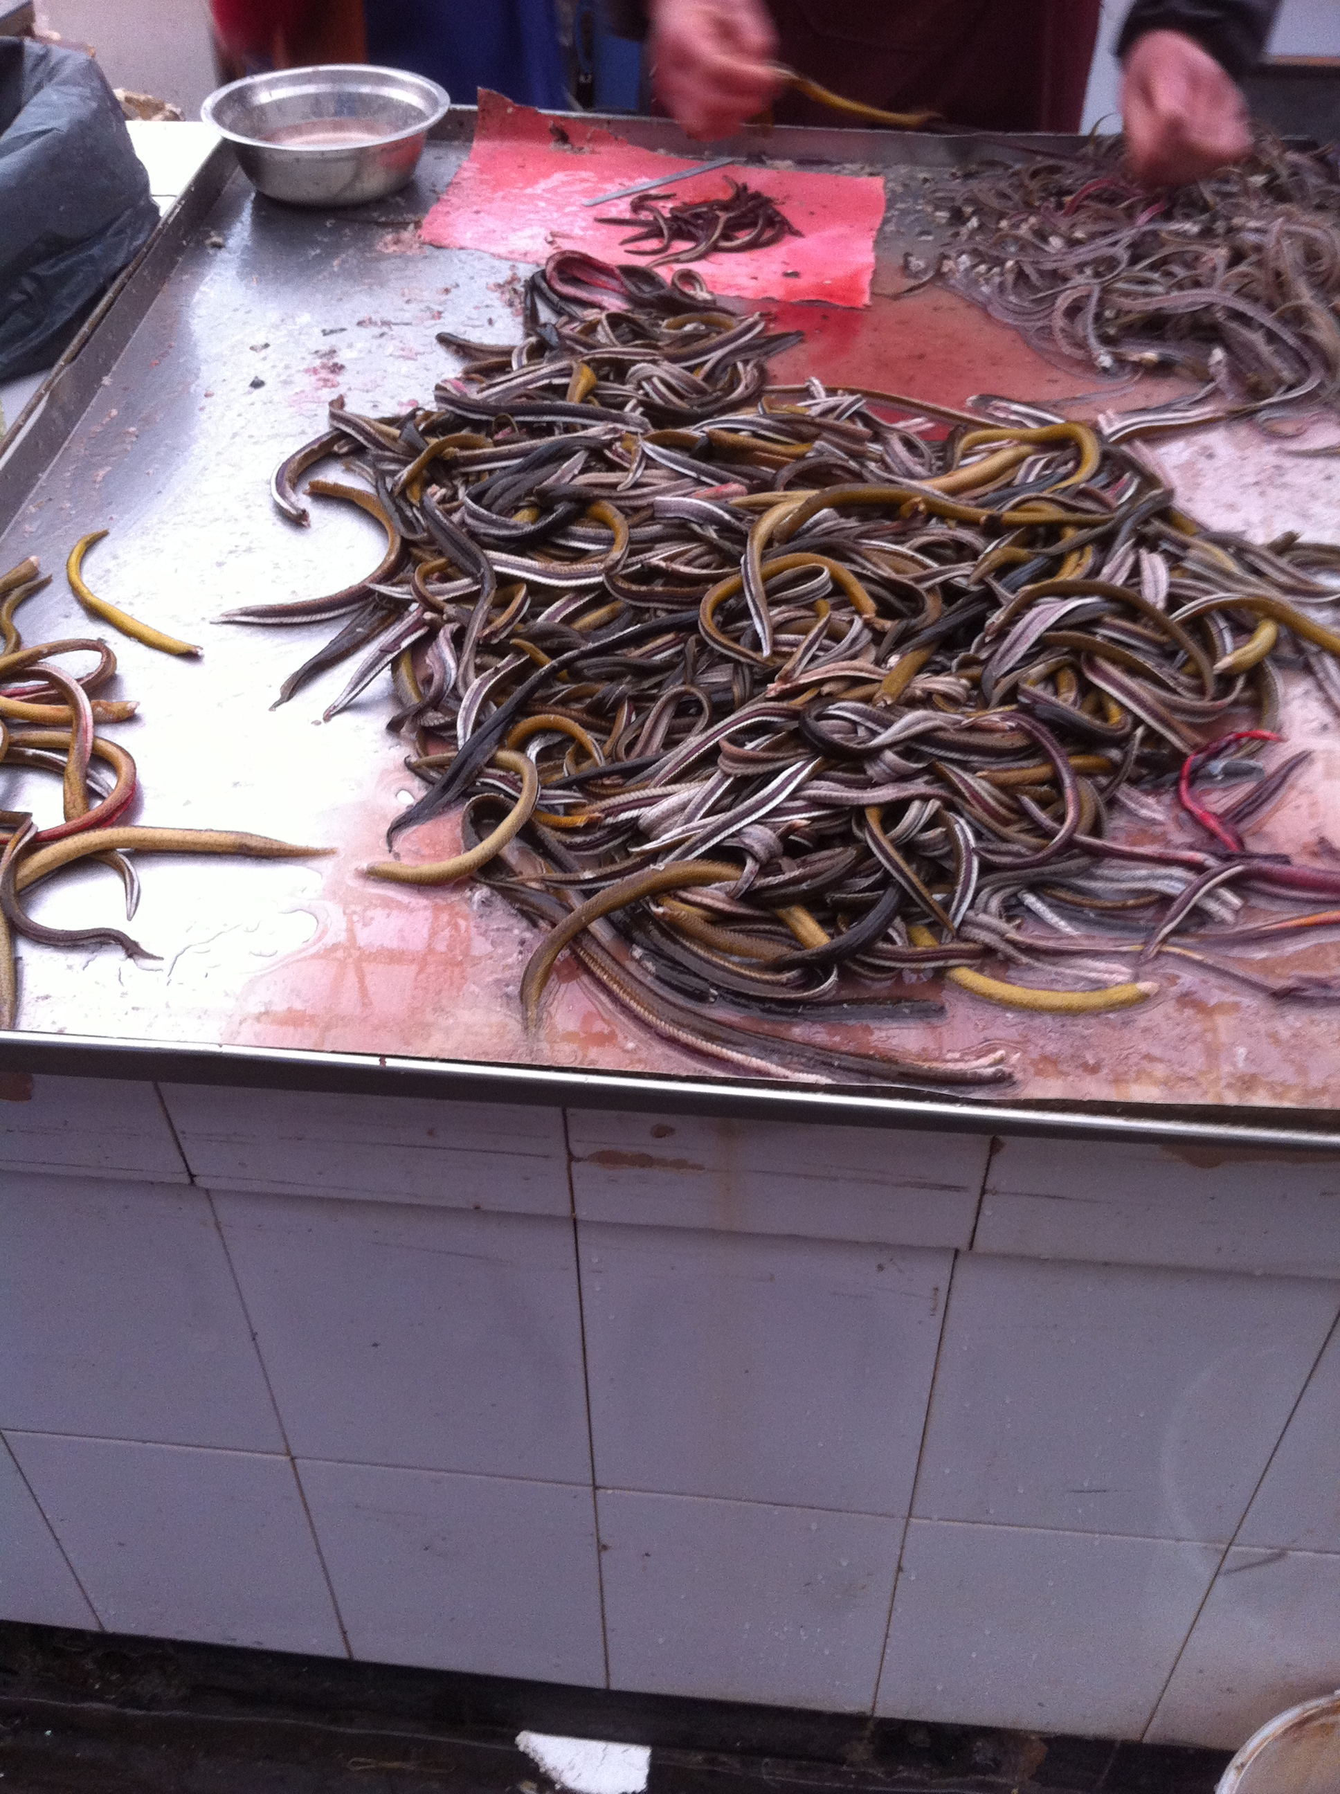
Questions?

Slide 50
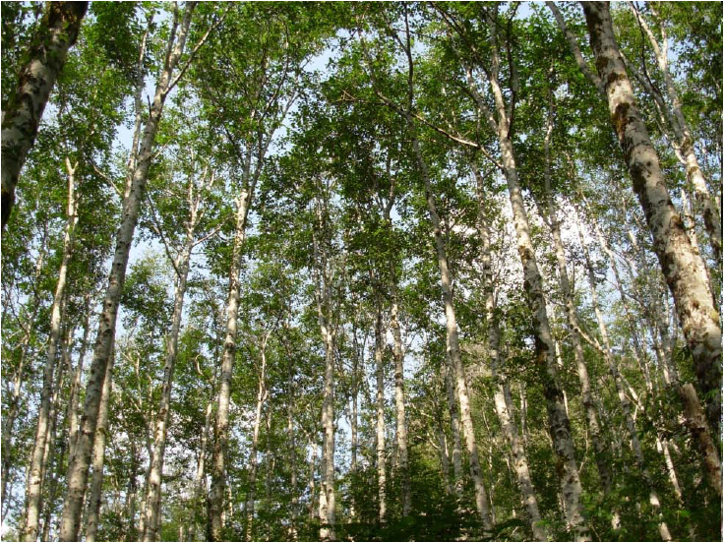
AMERICAN RED ALDER

Slide 51
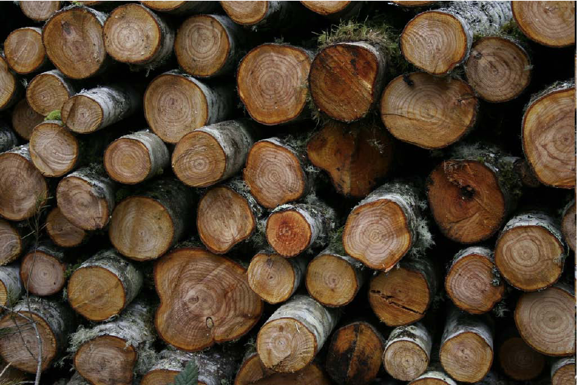
AMERICAN RED ALDER

Slide 52
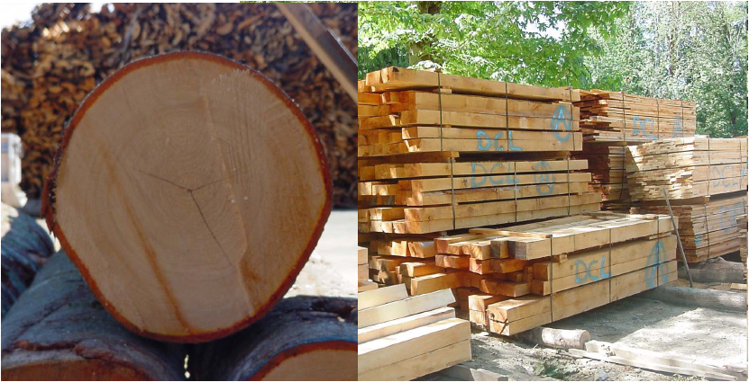
AMERICAN RED ALDER

Slide 53
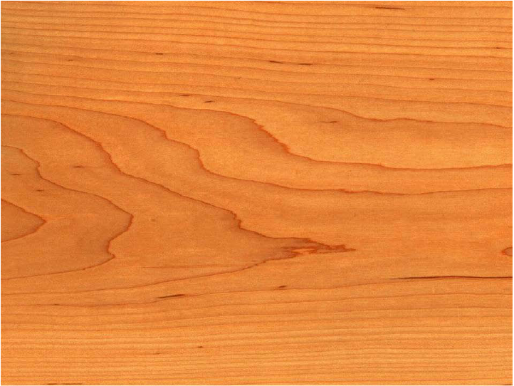
AMERICAN RED ALDER

Slide 54
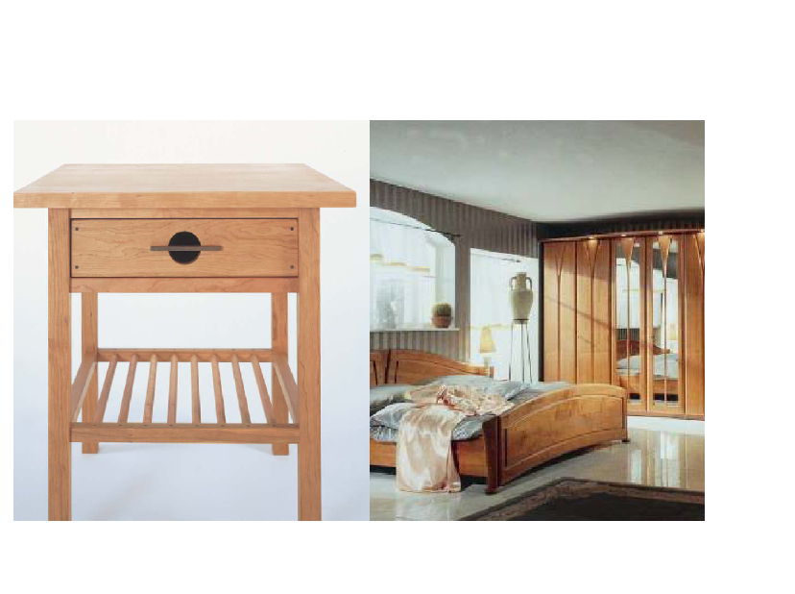
AMERICAN RED ALDER

Slide 55
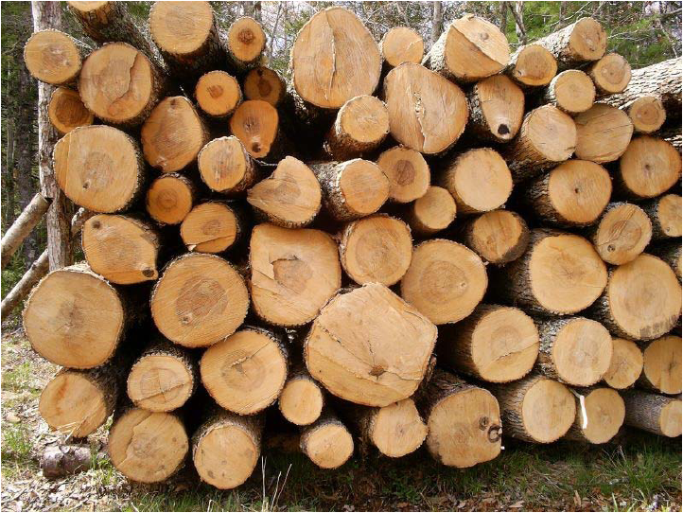
AMERICAN ASH

Slide 56
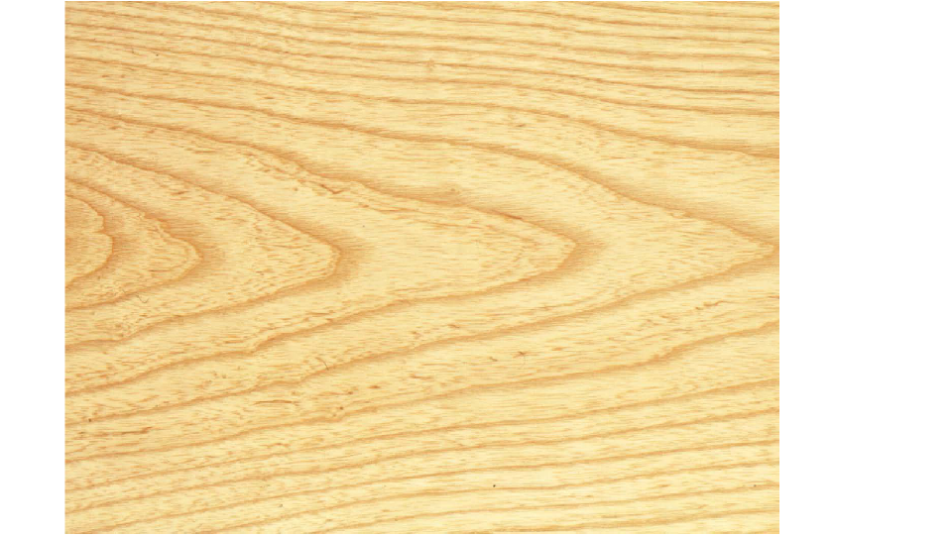
AMERICAN ASH

Slide 57
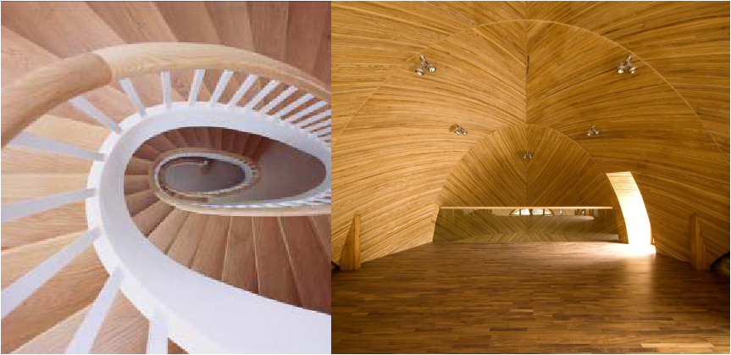
AMERICAN ASH

Slide 58
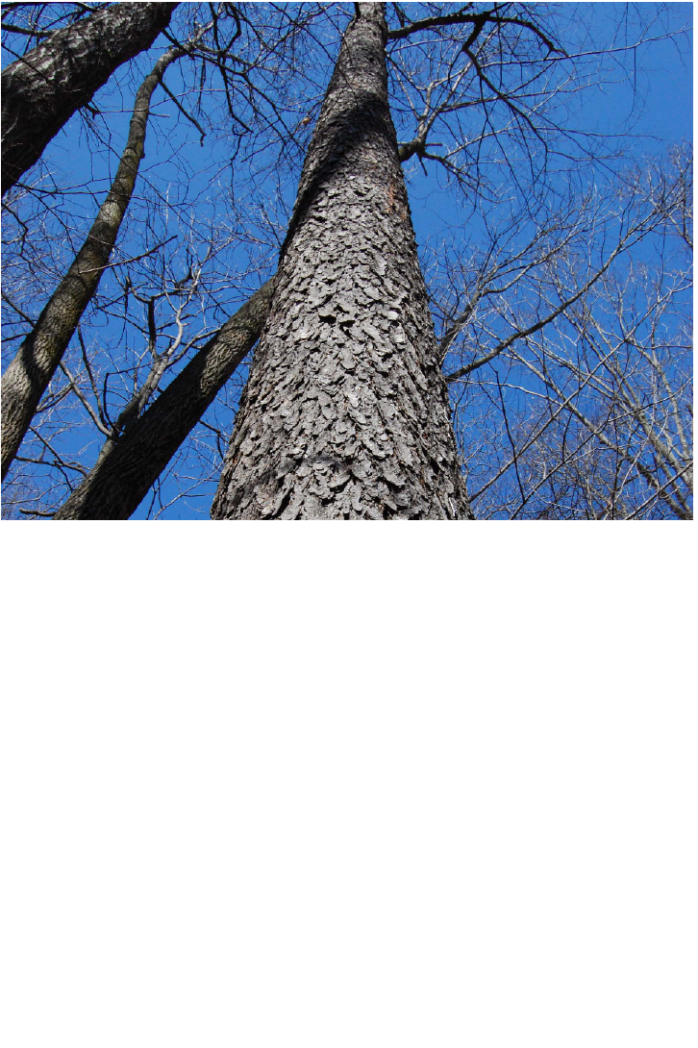
AMERICAN CHERRY

Slide 59
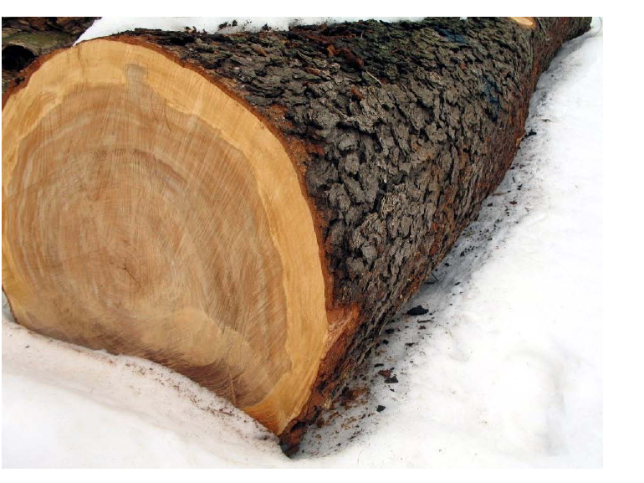
AMERICAN CHERRY

Slide 60
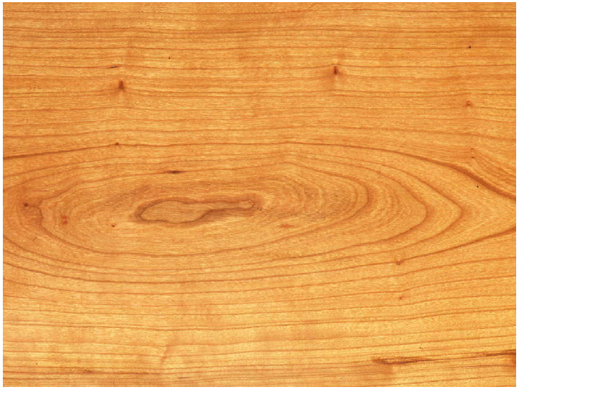
AMERICAN CHERRY

Slide 61
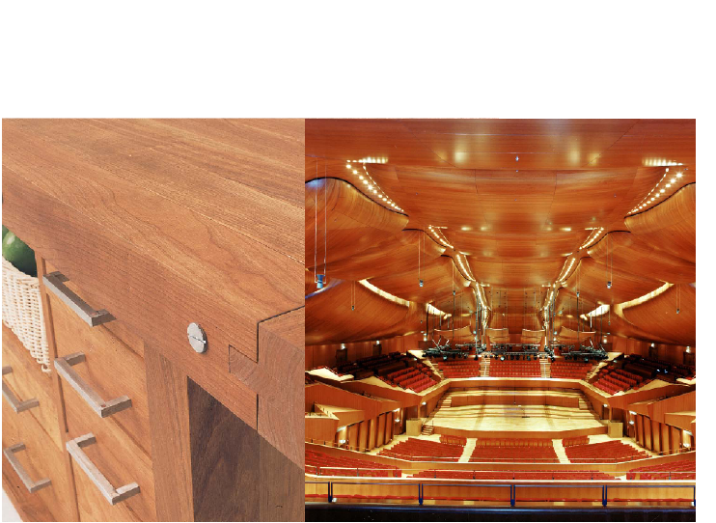
AMERICAN CHERRY

Slide 62
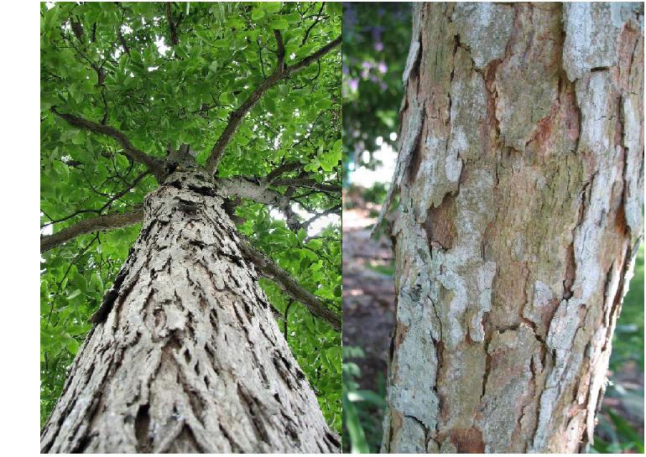
AMERICAN HICKORY & PECAN

Slide 63
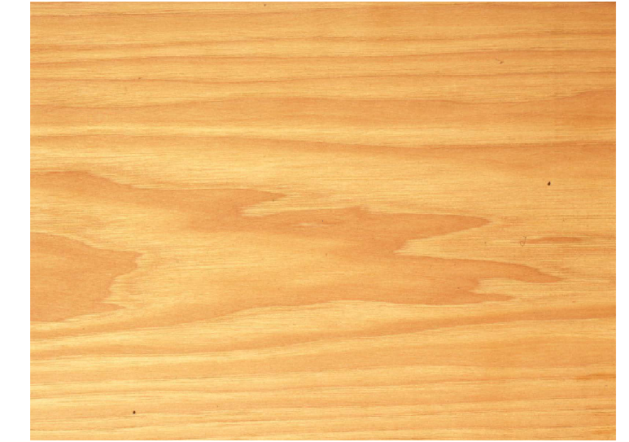
AMERICAN HICKORY

Slide 64
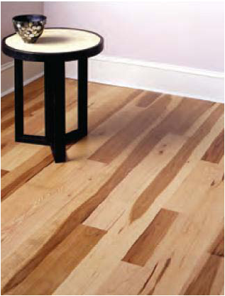
AMERICAN HICKORY

Slide 65

AMERICAN PECAN

Slide 66

AMERICAN HARD MAPLE

Slide 67

AMERICAN HARD MAPLE

Slide 68

AMERICAN HARD MAPLE

Slide 69

AMERICAN SOFT MAPLE

Slide 70

AMERICAN SOFT MAPLE

Slide 71

AMERICAN RED OAK

Slide 72

AMERICAN RED OAK

Slide 73

AMERICAN RED OAK

Slide 74

AMERICAN RED OAK

Slide 75

AMERICAN WHITE OAK

Slide 76

AMERICAN WHITE OAK

Slide 77

AMERICAN WHITE OAK

Slide 78

AMERICAN WHITE OAK

Slide 79

AMERICAN TULIPWOOD (YELLOW POPLAR)

Slide 80

AMERICAN TULIPWOOD (YELLOW POPLAR)

Slide 81

AMERICAN TULIPWOOD (YELLOW POPLAR)

Slide 82

AMERICAN TULIPWOOD (YELLOW POPLAR)

Slide 83

AMERICAN WALNUT

Slide 84

AMERICAN WALNUT

Slide 85

AMERICAN WALNUT

Slide 86

AMERICAN WALNUT

Slide 87


