Slide 1
FX insights and risk management
Helping you navigate global market complexities
George Vessey – UK Currency Strategist
Tom Rossiter – Corporate FX Dealer
This presentation is not a financial promotion and has been prepared and approved by Western Union International Bank GmbH, UK Branch. The information contained within this document does not constitute financial advice or a financial recommendation, is general in nature and has been prepared without taking into account your objectives, financial situation or needs.

Slide 2
A trusted partner
500
34
$5.6
Backed by a brand you can trust:
Fortune 500 company
transaction per second in 2018
billion revenue
130
200
95,000
Your partner for international success:
currencies
countries and territories
customers utilize business solutions services
Content not authorised for further distribution without prior written permission.

Slide 3
Industry landscape
The rise in politics and trade protectionism is distracting risk managers
The biggest worry today in FX risk management
Currency trends are increasingly being driven by factors that are extraordinarily hard to quantify and judge – geopolitics. FX volatility stemming from this geopolitical risk is distracting decision makers.
Over the past few years in the UK, making strategic payment and hedging decisions has become much more challenging due to issues such as Brexit.
“When future market scenarios are difficult to understand, this can make decisions daunting and distract from building or sticking to systematic FX risk management strategy” says David Renta, Global Head of Hedging at Western Union Business Solutions.
Content not authorised for further distribution without prior written permission.

Slide 4
What’s driving FX markets?
Less fundamentals, more politics
3-month implied GBP/USD volatility
Brexit
Increasing risk of no-deal Brexit in a Boris Johnson premiership - GBP/EUR fallen for seven consecutive weeks
Now hyper-sensitive to Brexit developments, GBP regularly swings 5% on a monthly basis
Trade wars
US-China trade conflict impacting financial markets and risk sentiment
Slowing economic growth concerns
Resolution at G20 summit this week?
Monetary policy
Most G10 central banks turning towards easing policy to support economies
Fed expected to cut rates twice in 2019
Geopolitical pressures
Escalating tensions globally, particularly in Middle East
Threat of US-Iran conflict sparking safe-haven demand: JPY, CHF and Gold all benefiting
Multiple spikes above key ceiling since Brexit vote
Chart source: Thomson Reuters and Western Union, June2019
Implied volatility (3M)
A gauge that measures the expected variation in the exchange rate over the next three months
An increase represents expectations of big shifts higher or lower
Content not authorised for further distribution without prior written permission.

Slide 5
Historical FX price action
GBP/USD exchange rate
GBP % change since June 2016 (UK voted to leave EU)
June 2016 (Brexit) $1.50
April 2018 $1.43
-13% in 8 months
-20% in 4 months
Rise of no-deal Brexit
scenario as UK-EU talks stall
GBP sell-off after leave vote +
BOE cut rate
March 2019 $1.3380
+18% in 6 months
December 2018
$1.25
October 2016
$1.20
Chart source: Thomson Reuters and Western Union, June2019
Chart source: Thomson Reuters and Western Union, June2019
Content not authorised for further distribution without prior written permission.

Slide 6
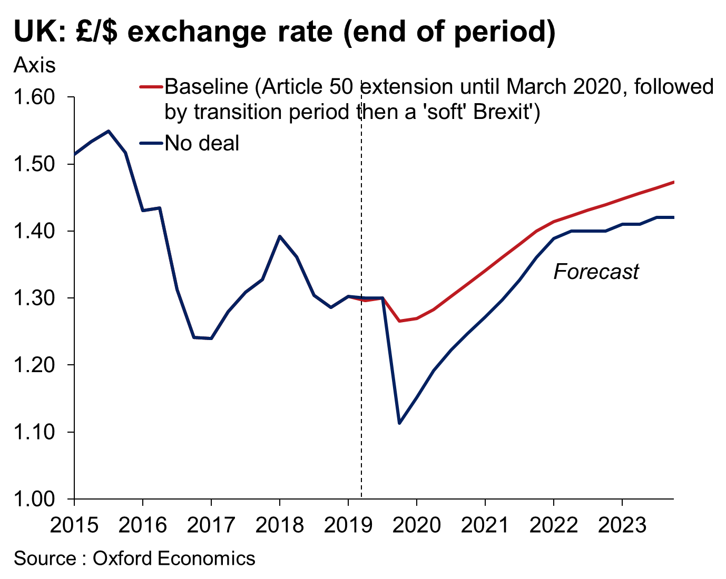
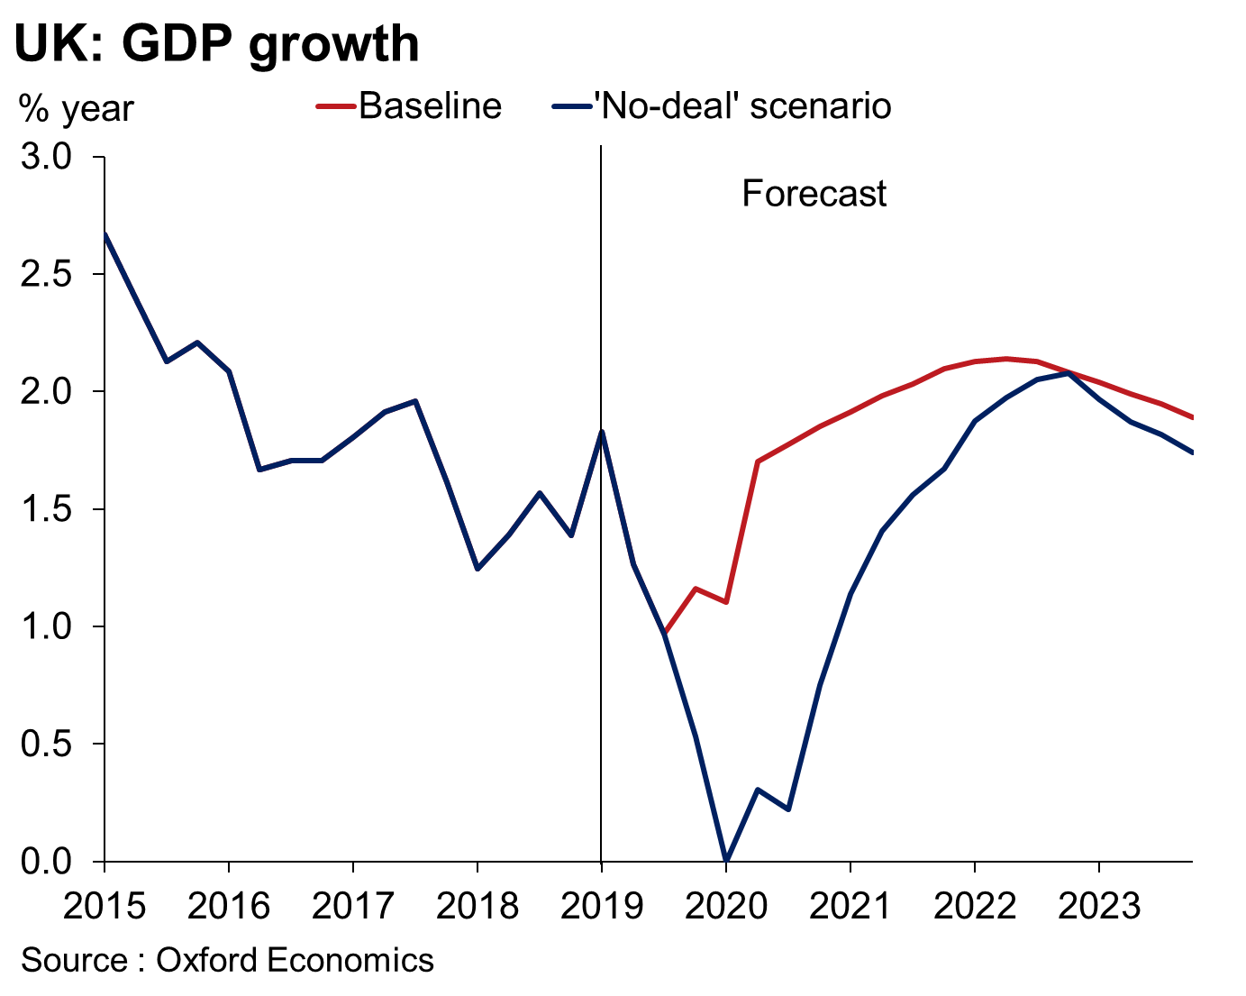
Brexit – “no deal”
Economic and currency outlook
‘No-deal’ Brexit (25%)*
Additional trade frictions –
Tariffs imposed on UK-EU trade and potentially trade with other countries where EU has FTAs
Non-tariff barriers erected
10% depreciation of Sterling on trade-weighted basis –
GBP/USD down to $1.10 in Q4 2019
GBP/EUR down to €1.00 in Q4 2019
Pound recovers but stays permanently below ‘deal’ level
Looser fiscal and monetary policy –
Bank Rate cut to 0.25%
EU budget contributions recycled into higher government spending. Could do same with tariff revenue
UK flirts with recession in early-2020
*Source: Oxford Economics
Content not authorised for further distribution without prior written permission.

Slide 7
Currency analysis
GBP/USD forecasts
GBP/USD median forecasts
 | AVERAGE FORECAST
3-MONTH | $1.28
6-MONTH | $1.3050
12-MONTH | $1.3450
GBP/USD historical averages
Chart source: Thomson Reuters June 2019 FX Poll. A total of 59 organisations submitted predictions at the beginning of the month. Strictly Thomson Reuters proprietary content. No redistribution allowed. Important Note: The exchange rate predictions displayed above are no guarantee of future results, and are not intended in any way as a recommendation to trade, or advice on whether to buy or sell. They are for informational purposes only and are subject to change. The exchange rates shown are also indicative only, and may vary compared to exchange rates quoted for transactions.
Chart source: Thomson Reuters and Western Union, June 2019
Content not authorised for further distribution without prior written permission.

Slide 8
Currency analysis
GBP/EUR forecasts
GBP/EUR median forecasts
 | AVERAGE FORECAST
3-MONTH | €1.15
6-MONTH | €1. 15
12-MONTH | €1.16
GBP/EUR historical averages
Chart source: Thomson Reuters June 2019 FX Poll. A total of 47 organisations submitted predictions at the beginning of the month. Strictly Thomson Reuters proprietary content. No redistribution allowed. Important Note: The exchange rate predictions displayed above are no guarantee of future results, and are not intended in any way as a recommendation to trade, or advice on whether to buy or sell. They are for informational purposes only and are subject to change. The exchange rates shown are also indicative only, and may vary compared to exchange rates quoted for transactions.
Chart source: Thomson Reuters and Western Union, June 2019
Content not authorised for further distribution without prior written permission.

Slide 9
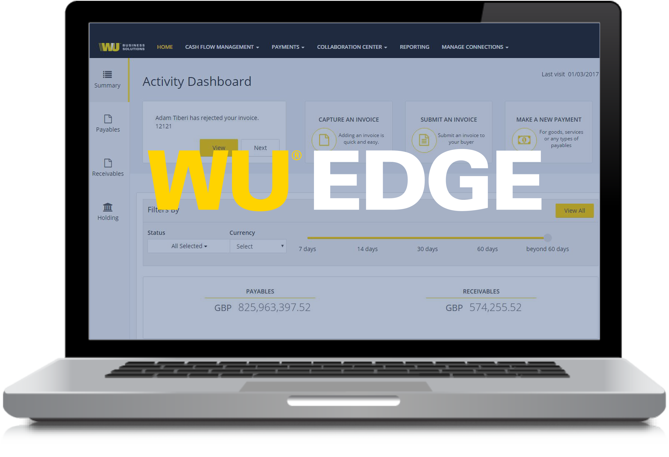
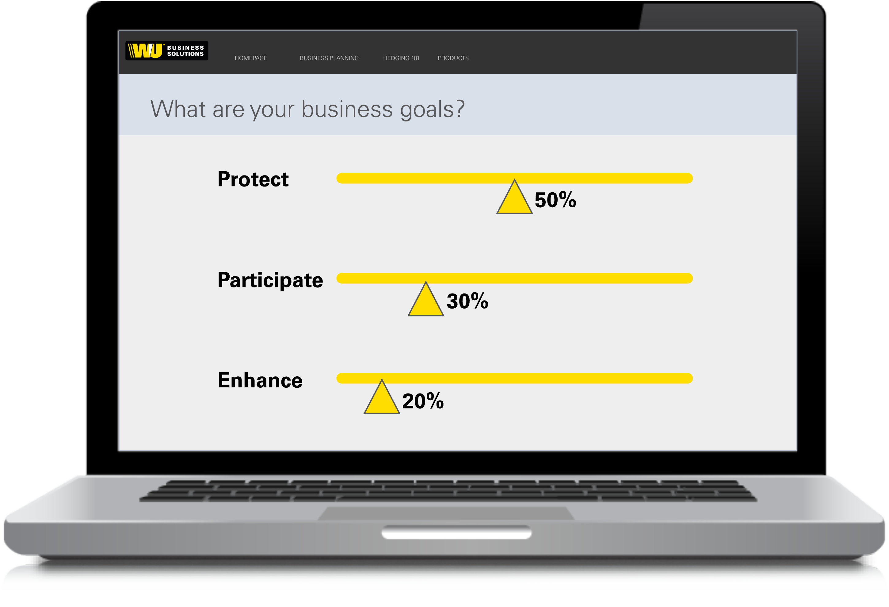
How can you prepare?
FX hedging solutions
1
2
REVIEW YOUR
Currency Exposures
Gain clear visibility of your past/future exposures
Identify currency risk at a glance
Simulate volatility and its impact on your profits
DEFINE YOUR
Business Goals
Protect profits from negative FX moves
Participate in favourable FX moves
Enhance or outperform current exchange rates
Content not authorised for further distribution without prior written permission.
© 2017 Western Union Holdings, Inc. Confidential.

Slide 10
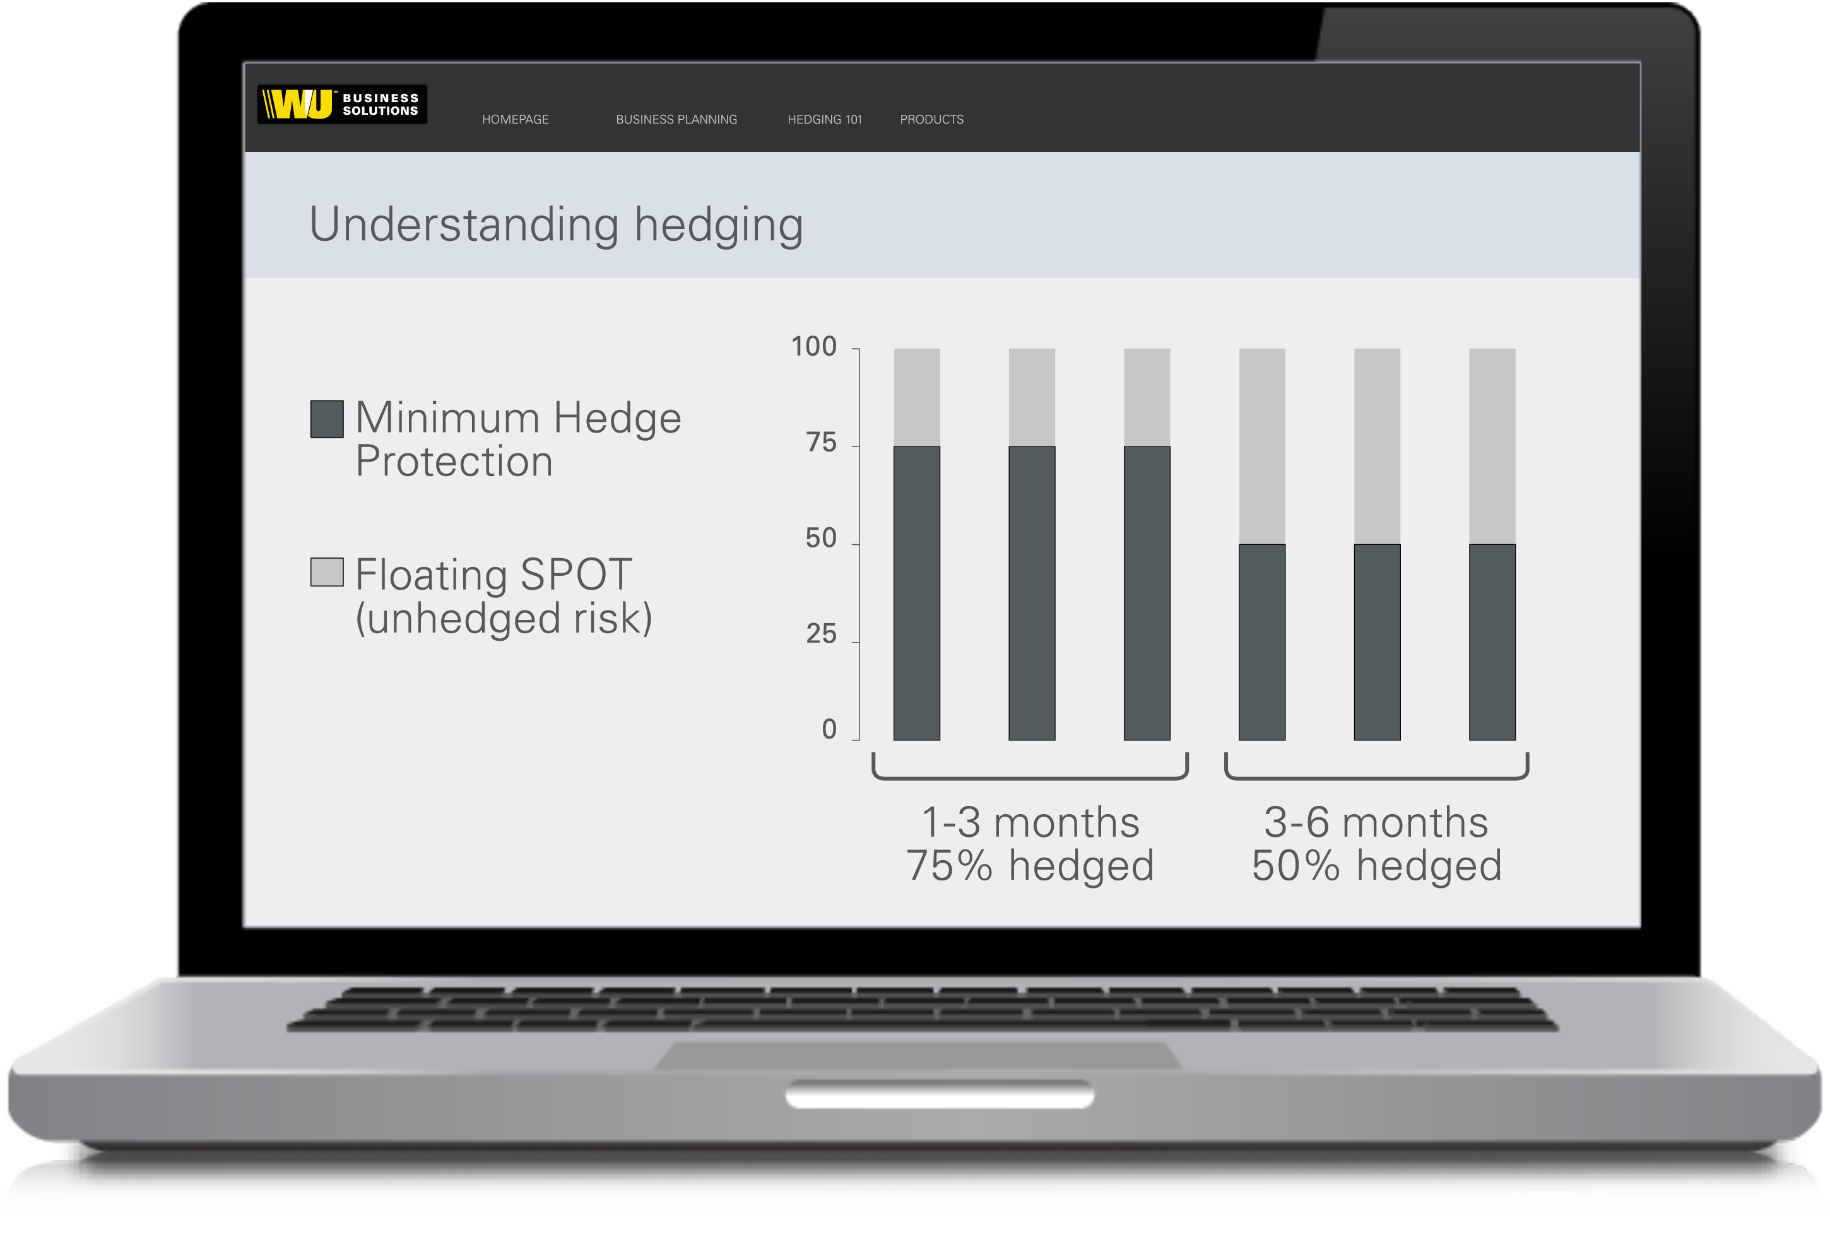
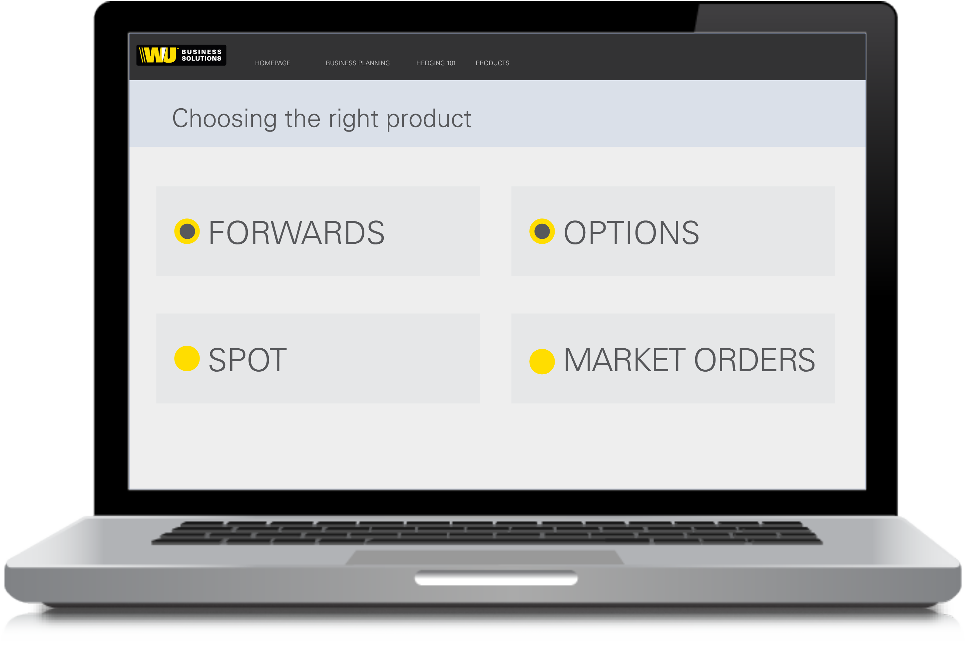
How can you prepare?
FX hedging solutions
3
4
DEVELOP YOUR
Hedging Strategy
Identify budget rate or cost rate
Understand market opportunities and risks
Set a minimum hedging threshold months
EXECUTE YOUR
Currency Plan
Forwards – Protect
Options – Protect and participate
SPOT – Immediate trades
Market Orders – Target or protect ideal rates
Content not authorised for further distribution without prior written permission.
© 2017 Western Union Holdings, Inc. Confidential.

Slide 11
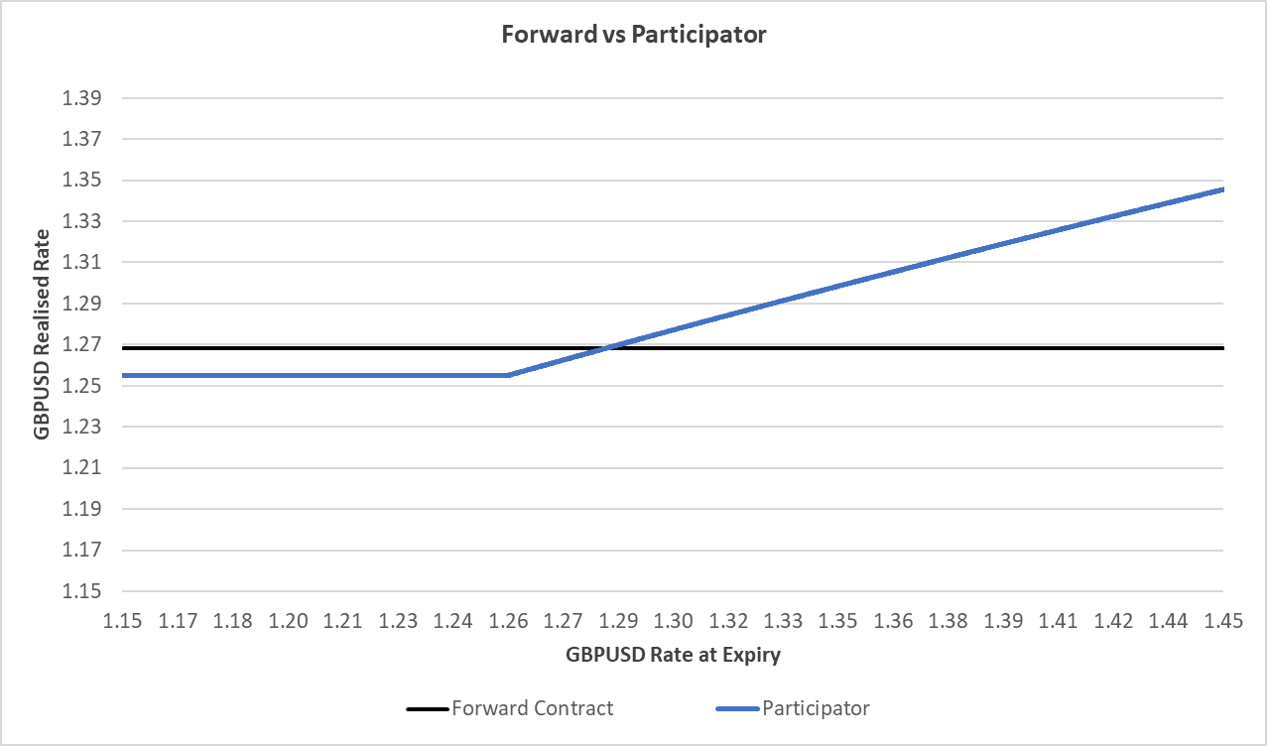
Trade idea: Participator
FX hedging solutions
Why would you use a Participator?
Protected known worse case rate with ability to “participate” in favourable exchange rate movements
Protection at all times with a known worst case exchange rate
Expiry | USD | Protection Rate | Particiaption
Jun-19 | 100,000 | 1.25 | 50%
Jul-19 | 100,000 | 1.25 | 50%
Aug-19 | 100,000 | 1.25 | 50%
Sep-19 | 100,000 | 1.25 | 50%
Oct-19 | 100,000 | 1.25 | 50%
Nov-19 | 100,000 | 1.25 | 50%
OUTCOMES AT EXPIRY (see chart):
If the market rate is below 1.25:
You have the right to buy $100,000 at 1.25
2. If the market rate is above 1.25:
You are obligated to deal 50% at 1.25 and have the right but not the obligation to deal the remaining 50% at the favourable spot rate
**Pricing subject to movements**
Risks or Disadvantages of the Participator
The Protection Rate will be less advantageous than a comparable Forward contract.
If the Spot Rate on expiry is more favourable than the Protection Rate you will still be obligated to deal a proportion of your requirement at the Protection Rate
If spot moves sufficiently higher, WUIB may require a margin call payment to secure your out-of-the money position
Content not authorised for further distribution without prior written permission.

Slide 12
Thank you
0800 026 0314* FX Hedging Desk
ukdealers@westernunion.com
business.westernunion.com/en-gb/fx-risk-management
© 2019 Western Union Holdings, Inc. All rights reserved.
This presentation is not a financial promotion and has been prepared and approved by Western Union International Bank GmbH, UK Branch. The information contained within this presentation does not constitute financial advice or a financial recommendation, is general in nature and has been prepared without taking into account your objectives, financial situation or needs. Western Union Business Solutions is a business unit of The Western Union Company and provides services in the UK through Western Union’s wholly-owned subsidiary, Western Union International Bank GmbH, UK Branch (WUIB).
WUIB (Branch Address: 131 Finsbury Pavement, London, EC2A 1NT) is a branch of Western Union International Bank GmbH (registered in Austria, company number FN256184t, VAT Number ATU61347377, with its registered office at Schubertring 11, 1010 Vienna, Austria), which is licensed by the Austrian Financial Market Authority (Finanzmarktaufsicht). WUIB is subject to limited regulation by the UK Financial Conduct Authority and Prudential Regulation Authority. Details about the extent of WUIB’s regulation by the Financial Conduct Authority and Prudential Regulation Authority are available from WUIB on request. This presentation has been prepared solely for informational purposes and does not in any way create any binding obligations on either party. Relations between you and WUIB shall be governed by the applicable terms and conditions. No representations, warranties or conditions of any kind, express or implied, are made in this presentation.
* The cost of your call will vary depending on your network provider and it is likely that calls from mobile phones will cost considerably more. We strongly recommend that you check with your network provider for potential costs.

